Slide 1
COVID 19 GUIDANCE
COVID 19 GUIDANCE
The following guidance is developed as healthcare facilities prepare for COVID patients, and is based on input from ASHE, ASHRAE Technical Committee for Healthcare and ASHRAE/ASHE Standard 170 Committee.
This guidance represents personal opinions and ASHRAE and ASHE are not responsible for the use or application of this information. Please contact Michael.sheerin@tlc-eng.com (Chair ASHRAE Standard 170) for questions.

Slide 2
Experts Across the Country
Acknowledgements
This information wouldn’t exist without the shared expertise of many people. We are grateful to the following and apologize if we missed anyone herein:
Jonathan Flannery, ASHE
Traci Hanegan, Coffman Eng –
Chair ASHRAE Tech Comm for Healthcare
ASHRAE Standard 170 Committee especially Kevin Scarlett / John Williams (Wash State) and Ken Mead (CDC)
TLC Engineering Solution Healthcare Center of Excellence Team including Aaron Johnson, Mark Costello, Jeff Stone and Ben Roseborough along with COO Jim Ferris and EVP Bob Danner

Slide 3
Summary
COVID 19 in Perspective
Action Plan
Implementation
Other Factors

Slide 4
Why is this a Big Deal ?
COVID 19 in Perspective

Slide 5
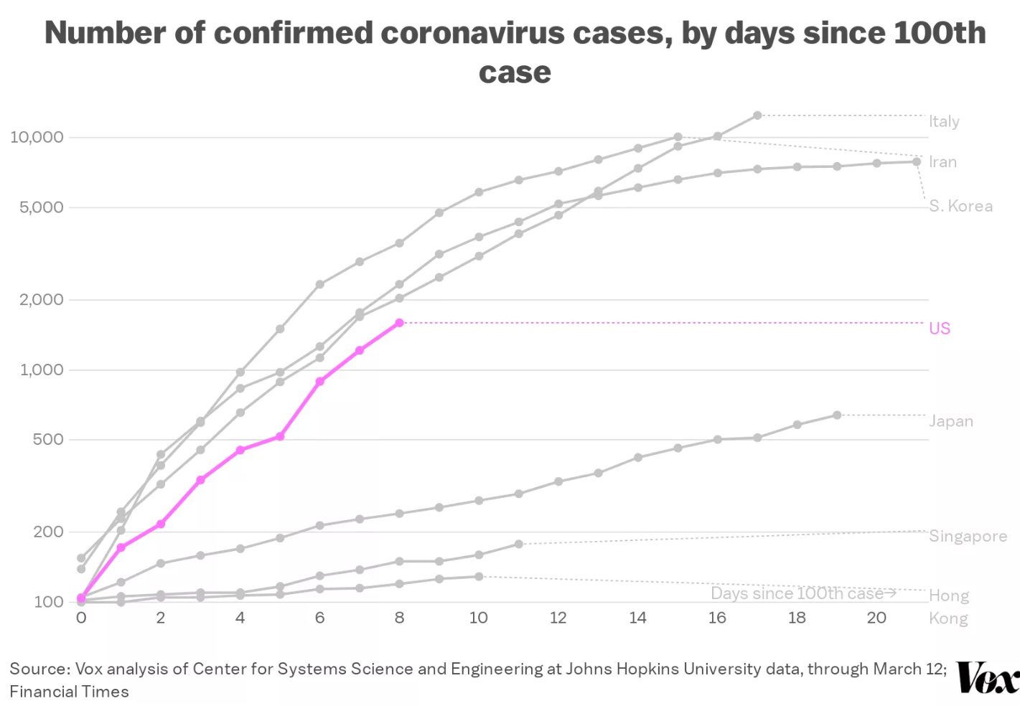
Point of Rapid Expansion
Testing & ID
in S Korea
Notes:
TREND LINE IS NOT GOOD

Slide 6
Perspective
Perspective
True number of cases in an area are vastly under-counted due to quantity of undiagnosed and untested patients. They may still arrive at the hospital.
Two ways to estimate “true” number of cases:
# of Reported Cases x 10-20
# of COVID Deaths x 400

Slide 7
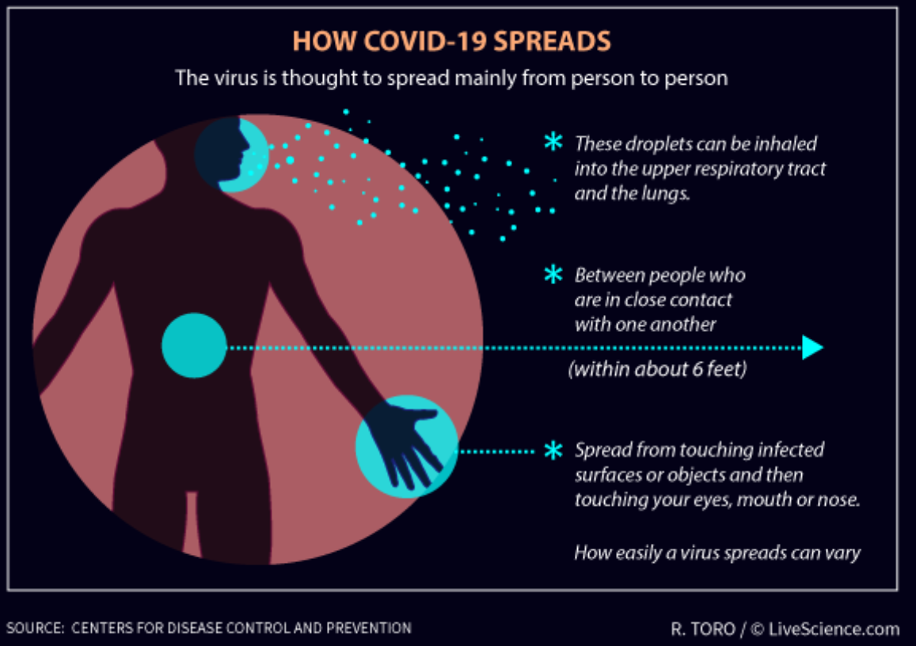
Perspective
Perspective
COVID 19 is viable on surfaces for 2-3 days
COVID 19 is viable aerosolized for at least 3 hours

Slide 8
Perspective
Perspective
Transmission rate appears comparable to influenza
25% of cases transmitted while asymptomatic (first 24-48 hrs)
But…most contagious when they are most symptomatic (sickest) – like in a hospital !

Slide 9
Perspective
Perspective
At risk populations frequently become more severe cases
15% of infected require oxygen interventions
3-4% mortality rate vs 0.1% for influenza (30x higher)
80 yrs and older mortality rate is near 15% (70 = 8%, 60 = 3%)
Nursing home / Assisted Living residents at high risk

Slide 10
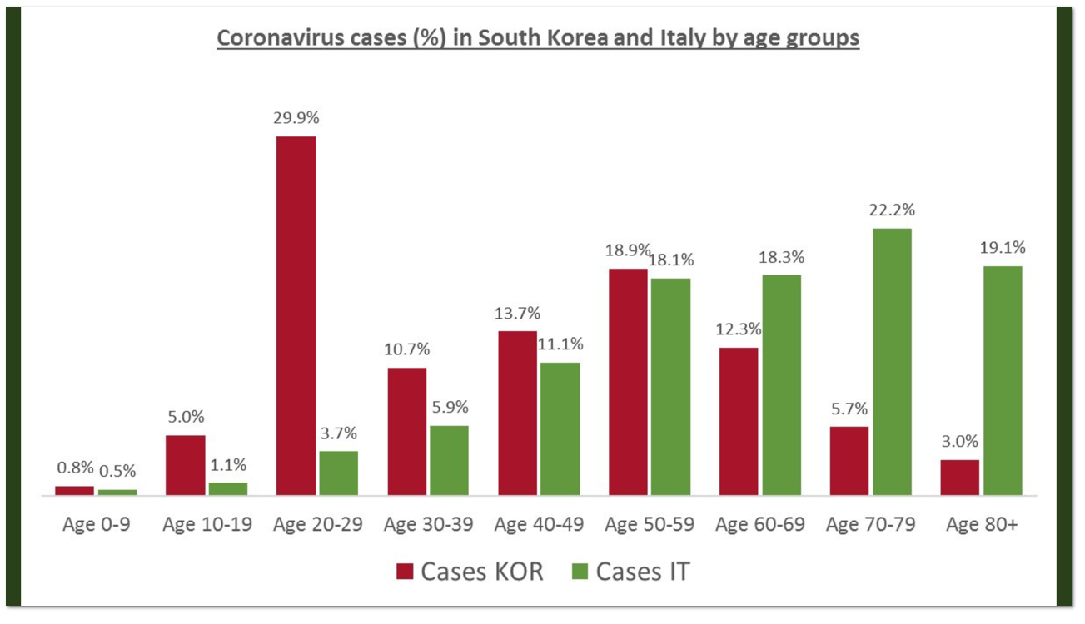
Perspective
Recent Info
Young Folks May Unknowingly Have COVID and Spread COVID
Notes:
THEY ARE ACTUALLY TESTING IN S KOREA / NOT SO MUCH IN ITALY AND FINDING YOUNG ADULTS ARE OFTEN NOT SYMPTOMATIC BUT SPREADING THE VIRUS

Slide 11
Perspective
Perspective
As this is normal flu season, and snowbird season in FL, most hospitals are running at higher capacity presently. COVID influx will stretch normal conditions and may overcome their capacity. Without strategies and alternatives, patient needs will not be met.
Hospitals have Airborne Infectious Isolation (AII) Rooms, generally 1-2 per patient floor or suite. These rooms would normally be used for suspected COVID patients, along with other infectious conditions such as TB.
As numbers increase, too few AII rooms will be available to house suspected COVID patients.

Slide 12
Perspective
Perspective
The general course of growth from suspected cases to a high number of cases is commonly shorter than the time frame for treatment and release of “first in” patients, so it is important to recognize that committing AII rooms to patients limits future flexibility.
CDC is recommending that AII rooms be used only for COVID patients undergoing aersol generating procedures (AGP).
Examples of AGP are positive pressure ventilation (BiPAP and CPAP), endotracheal intubation, airway suction, high frequency oscillatory ventilation, tracheostomy, chest physiotherapy, nebulizer treatment, sputum induction, and bronchoscopy.

Slide 13
Perspective
Perspective
CDC has provided recent guidance that “facilities could consider designating entire units” to care for known or suspected COVID patients. These units would be staffed with dedicated healthcare personnel to limit exposure risk.
We strongly advise against cohorting suspected and confirmed patients in the same unit/suite, to avoid the potential for conversion. Work with clinical staff on this matter.

Slide 14
Perspective
Perspective
In order to manage patient influx, congestion and to control the risk of exposure to healthcare workers, hospitals are restricting access to Emergency Dept to ambulatory patients only, and designating a specific area in ED for respiratory cases.
Persons Under Investigation (PUI) capable of self care are triaged outside the ED, either through drive-through or walk up screening stations set up in tent or temporary space, and advised to continue home care until results are available.
Nursing Homes and Assisted Living Facilities should be checking staff before every shift and visitors for flu-like conditions and temperature and travel history (required in FL). In hard-hit Seattle, they are restricting visitors to a resident room or halting visits altogether.

Slide 15
Action Plan
2. Action Plan
There are many unknowns so the only sensible act is ensure that we are helping clients be prepared:
Reach out to Hospital and Senior Living clients
Share the Knowledge and Info
Answer Questions and Be a Resource
Be On-Call and Help
Reassure Them – Preparation is Positivity

Slide 16
Action Plan
2. Action Plan
Main Steps:
Verify Performance of Existing Airborne Infectious Isolation Rooms
Verify Performance of Emergency Department HVAC System
Secure all HEPA UNITS
Develop Surge/Temporary Patient Segregation Plan & Deploy
Ensure Critical Equipment is Powered on Critical or Equip Branch

Slide 17
How ?
3. Implementation
Our primary function and expertise in preparation for COVID 19 is advising on HVAC system, configurations and modifications to support the safe segregation of suspected and confirmed patients within controlled air environments, whether true isolation or modified alternative arrangements, as best suits their needs.

Slide 18
Basics
Basics
General Parameters:
Do No Harm
System Arrangement Should Protect Workers
System Arrangement Should Protect Other Patients
Airflow from Clean to Less Clean
Reminder - Do NOT house suspected/PUI cases in the same suite as Confirmed COVID Patients.

Slide 19
Basics
Basics
Normal mode - COVID patients best practice placement in Airborne Infectious Isolation (AII) Rooms
Small Scale Surge Capacity Mode – Create Additional Dedicated AII or Temporary Patient Observation/Segregation Rooms with HEPA and negative pressure.
Large Scale Surge Capacity Mode – Establish Dedicated Ward/Suite(s) and Establish Protocols with Clinical and Environmental Action Plans
Understand: Temporary Patient Observation/Segregation areas are not True AII Rooms and that is OK.

Slide 20
Basics
Warning – ICU Rooms
COVID Patients May Require Intensive Care Treatment
ICU Rooms May Be Positive Pressure – Verify and Address !
Designate Specific Room(s) or Area(s)
Proactively Review and Modify Test and Balance as Needed
Consider System Level, Once Through Air Approach Described Below
Recognize That Changing the Outdoor Air Amount Might Impact Building Pressure Balance and Also Create Humidity Issues if Unmanaged

Slide 21
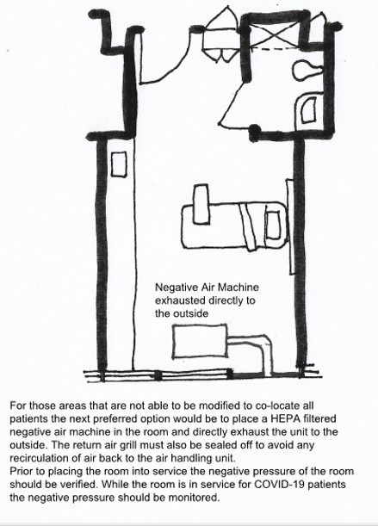
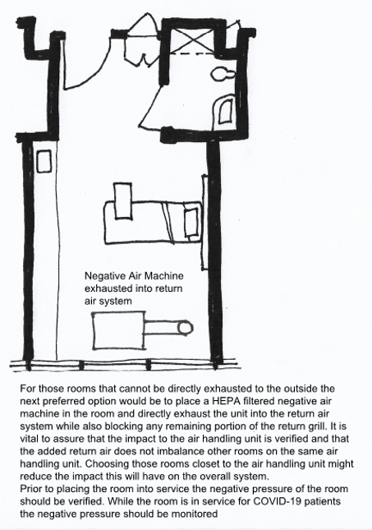
Patient Room
Examples - Patient Rooms

Slide 22
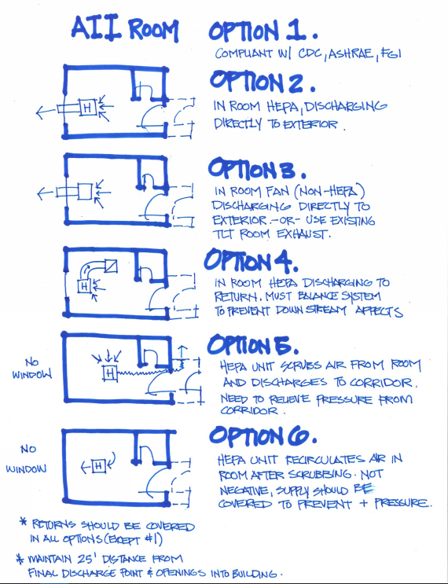
Patient Room
VARIETY OF APPROACHES – EVALUATE WHAT WORKS BEST FOR YOUR CONDITION(S)
Consider:
-Door Closer
-Ability to Monitor Room Pressure
-Limit Patient Transfers
-Ventilate and Terminal Clean Before Re-Use

Slide 23
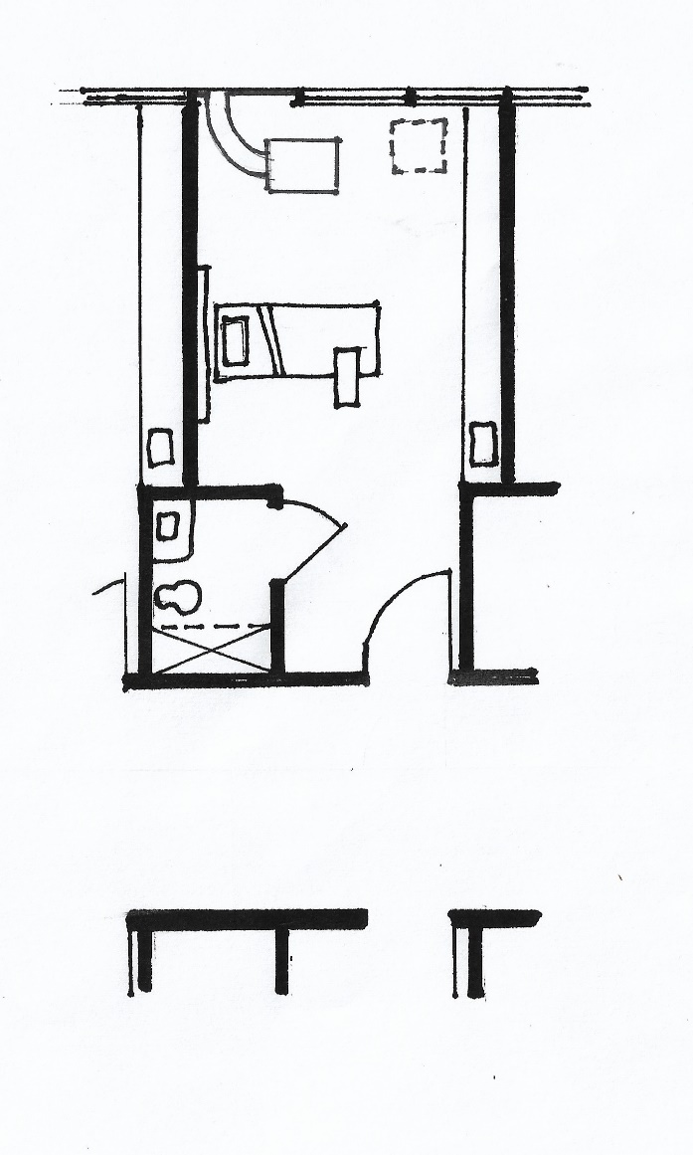
Perspective
Examples - Patient Rooms
SMALL SCALE SURGE
HEPA to Outside
Single patient room with dedicated bathroom
Seal off return air grill in patient room
Place HEPA filtered negative air machine in patient room
Duct through exterior to outside
Remove window and enclose opening
Keep door to patient room closed
Verify negative pressure prior to placing room in service and monitor negative pressure while in service
Limit patient transport and patient transfers
Terminal cleaning after ACH removes potentially infections particles

Slide 24
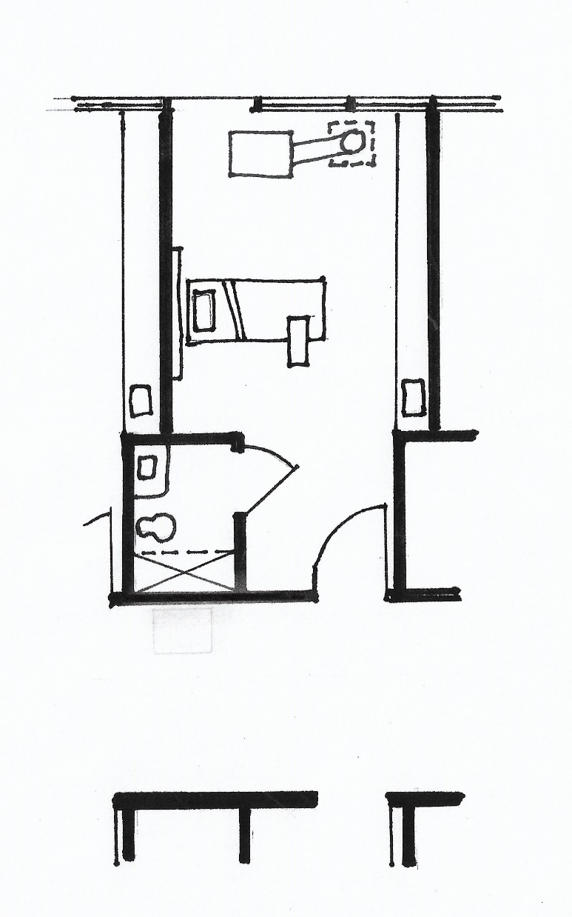
Patient Room
Examples - Patient Rooms
SMALL SCALE SURGE
HEPA to Return
Single patient room with dedicated bathroom
Place HEPA filtered negative air machine in patient room
Duct to return air grill
Seal off remaining part of return air grill
Verify impact that this will have to the overall air handling system – choosing rooms closest to the air handler may reduce impact
Keep door to patient room closed
Verify negative pressure prior to placing room in service and monitor negative pressure while in service
Limit patient transport and patient transfers
Terminal cleaning after ACH removes potentially infections particles

Slide 25
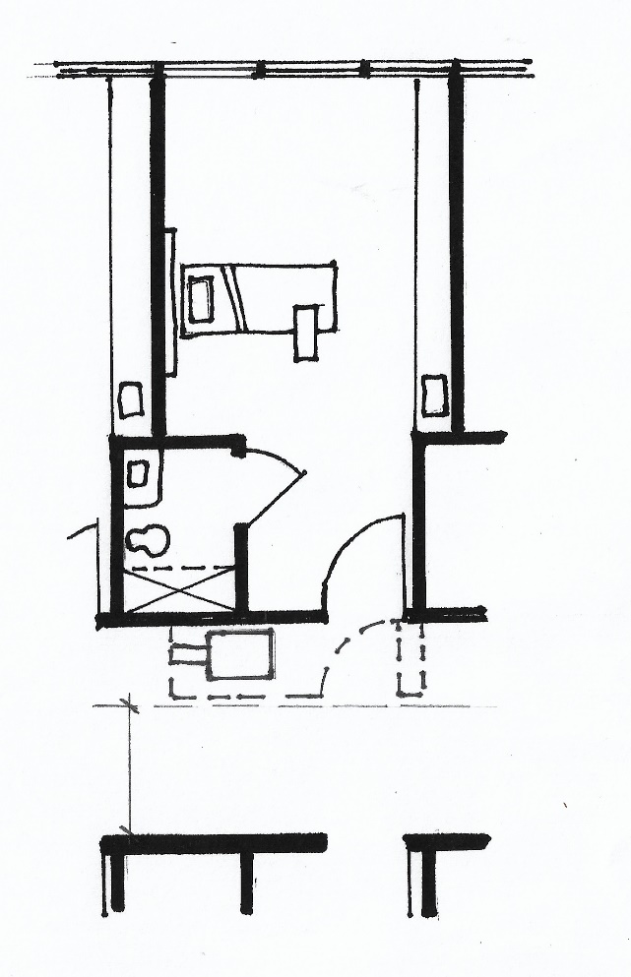
Patient Room
Examples - Patient Rooms
SMALL SCALE SURGE
HEPA to Corridor
Single patient room with dedicated bathroom
Create “airtight” vestibule to patient room
Need minimum 5’-0” egress clearance in the corridor
Seal off return air grill in patient room
Place HEPA filtered negative air machine in vestibule
Duct through vestibule to corridor
Keep door to vestibule closed but door to patient room open
Verify that patient room door is not a rated fire door!
Verify negative pressure prior to placing room in service and monitor negative pressure while in service
Limit patient transport and patient transfers
Terminal cleaning after ACH removes potentially infections particles

Slide 26
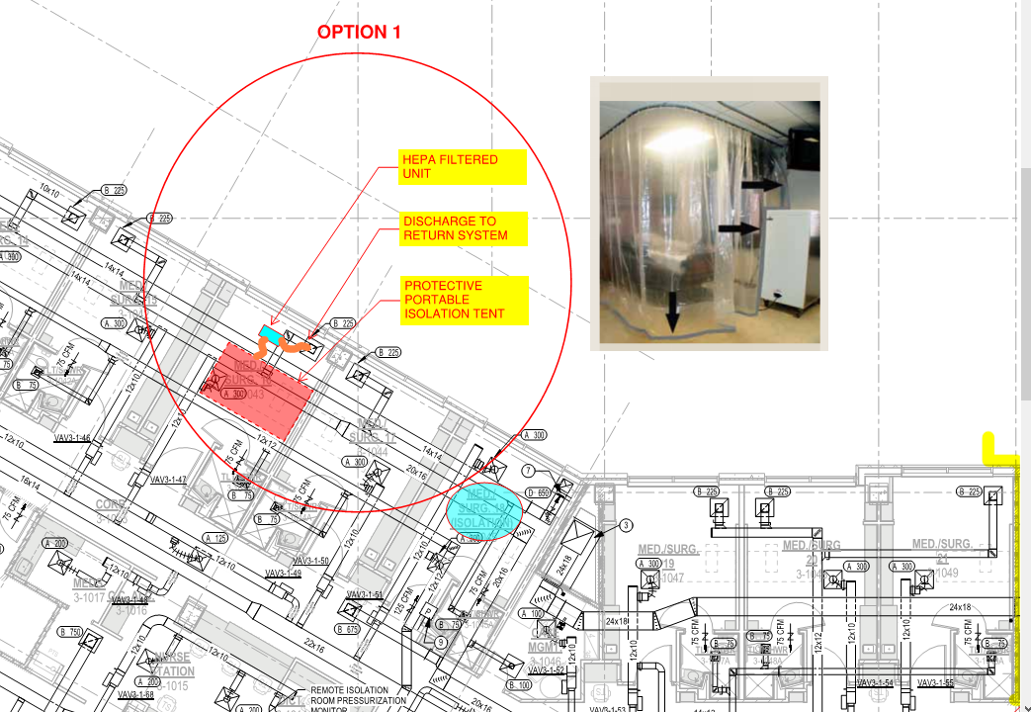
Example – Patient Room
7
Examples - Patient Rooms

Slide 27
Basics
Warning – Rooms with Fan Coil Units
Avoid Use for COVID Patients IF YOU CAN
IF YOU MUST:
Avoid Contaminating Fan Coil Unit IF YOU CAN
Consider Option 7 (previous slide) as Best Approach
Fan Coil Unit Has Inadequate Air Changes, Filtration for This Purpose
If No Other Option Than Using Fan Coil, Then Increase Room Exhaust
May Be Accomplished By Adding Supplemental Local Exhaust Fan per Room
Consider System Level Approach By Enhanced Toilet Exhaust Airflow
Consider Means of Sanitizing Fan Coil Between Patients – Peroxide Fog, Other?
Deep Decontamination of Fan Coils After Event Is Over

Slide 28
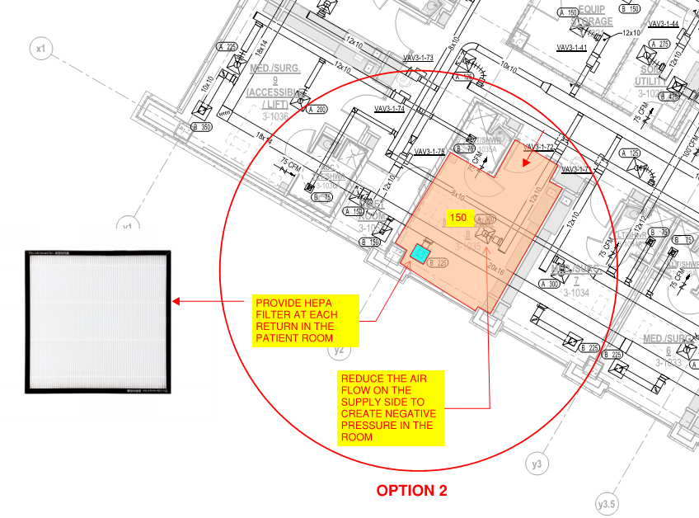
Example – Patient Room
8

Slide 29
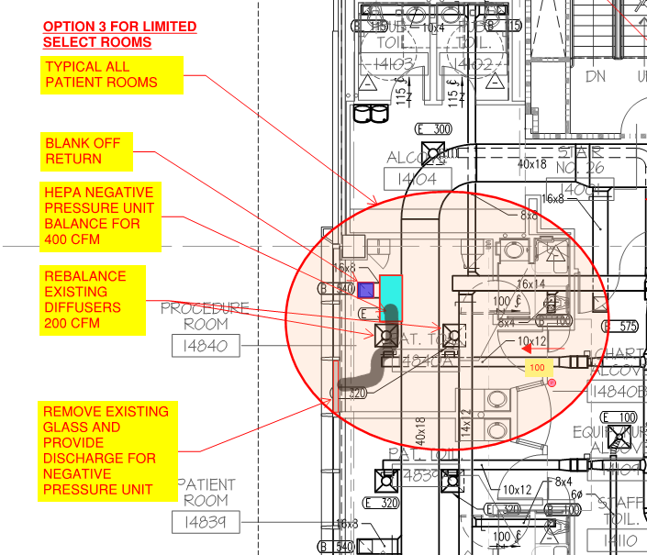
Example – Patient Room

Slide 30
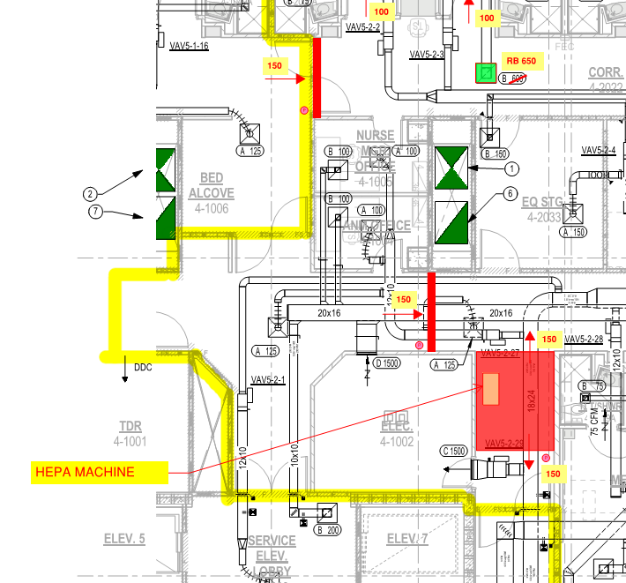
Control Vestibule

Slide 31
Typical Air Handler
Relief Air from Patient Rooms
With AIRSIDE ECONOMIZER
Increase Bathroom Exhaust Airflow to Create Room Negative Pressure
Return Air from Patient Rooms
Outside Air
Supply Air to Patient Rooms
HVAC – Once Through Air
Block Off
AHU

Slide 32
Typical Air Handler
Temp Exhaust Air from Patient Rooms
NO AIRSIDE ECONOMIZER
Increase Bathroom Exhaust Airflow to Create Room Negative Pressure
Block Off
Return Air from Patient Rooms
Outside Air
Supply Air to Patient Rooms
HVAC – Once Through Air
Pre-Conditioned Outside Air
AHU
Lower Chilled Water Supply Temp as Needed for Humidity Control / Capacity

Slide 33
Perspective
Further Considerations
Emergency Department
Restrict Access (?)
Triage Protocols - Off-Site (?)
Manage Patient Waiting Areas
Use of UV or Peroxide Disinfectant Systems for Rooms
Evaluate Air System Operation and Alternative Measures
Example: Convert Open Bay or Trauma Room with Use of HEPA Recirculation Unit to Multiple Patient Station
Example: Convert AHU temporarily to Once Through Air System, supplement make up air needs with temporary A/C as needed
Have a Contingency / Fall-Back Plan

Slide 34
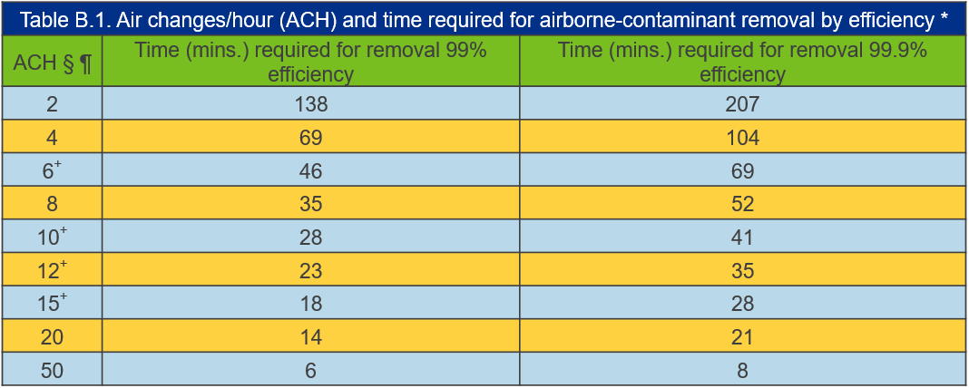
Perspective
Further Considerations
Ventilate the Room and Terminal Clean before Re-use
Follow CDC Air Change Clearance Rates:

Slide 35
The Wider Picture
4. Other Factors
Infrastructure
Code Compliance
“Flatten the Curve”
“Super-spreaders”
PPE Guidance
Services:
Expand Existing
Explore/Add New
Geography:
Texas to Eastern Seaboard

Slide 36
Other Factors
Infrastructure
Assume increased demand for oxygen therapy. Assess bulk oxygen capacity and top off; develop a re-filling plan if already frequent.
Coordinate with biomedical regarding stores of O2 hoses, masks, humidifiers and portable oxygen cylinders. ECMO has been needed for severe cases.
Considering the possibility of being short-staffed in the future, consider run-testing and re-fueling emergency generator system.

Slide 37
Other Factors
Code Compliance
Coordinate with State and Local Authorities
Seek Guidance / Reach Out for Help
Take Appropriate Action Based on Circumstances
Reminder to Document the Action Plan and Alterations in Place.
Develop Interim Life Safety Measures as applicable
Upon Cessation of Cases: Establish Disinfection Plan Before Returning HVAC System to Normal Operation (Grilles, Duct, Air Handler)

Slide 38
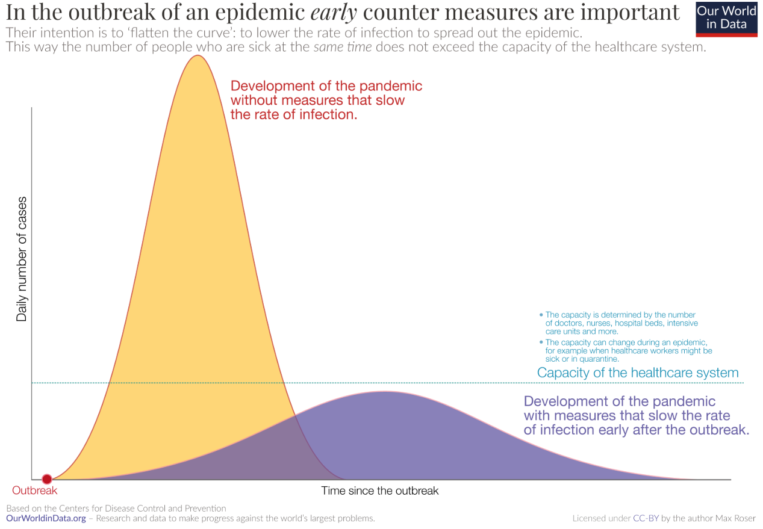
Other Factors
Flatten the Curve
SLOW THE SPREAD AND REDUCE PEAK NUMBER – BUT MEANS LONGER TIME DURATION

Slide 39
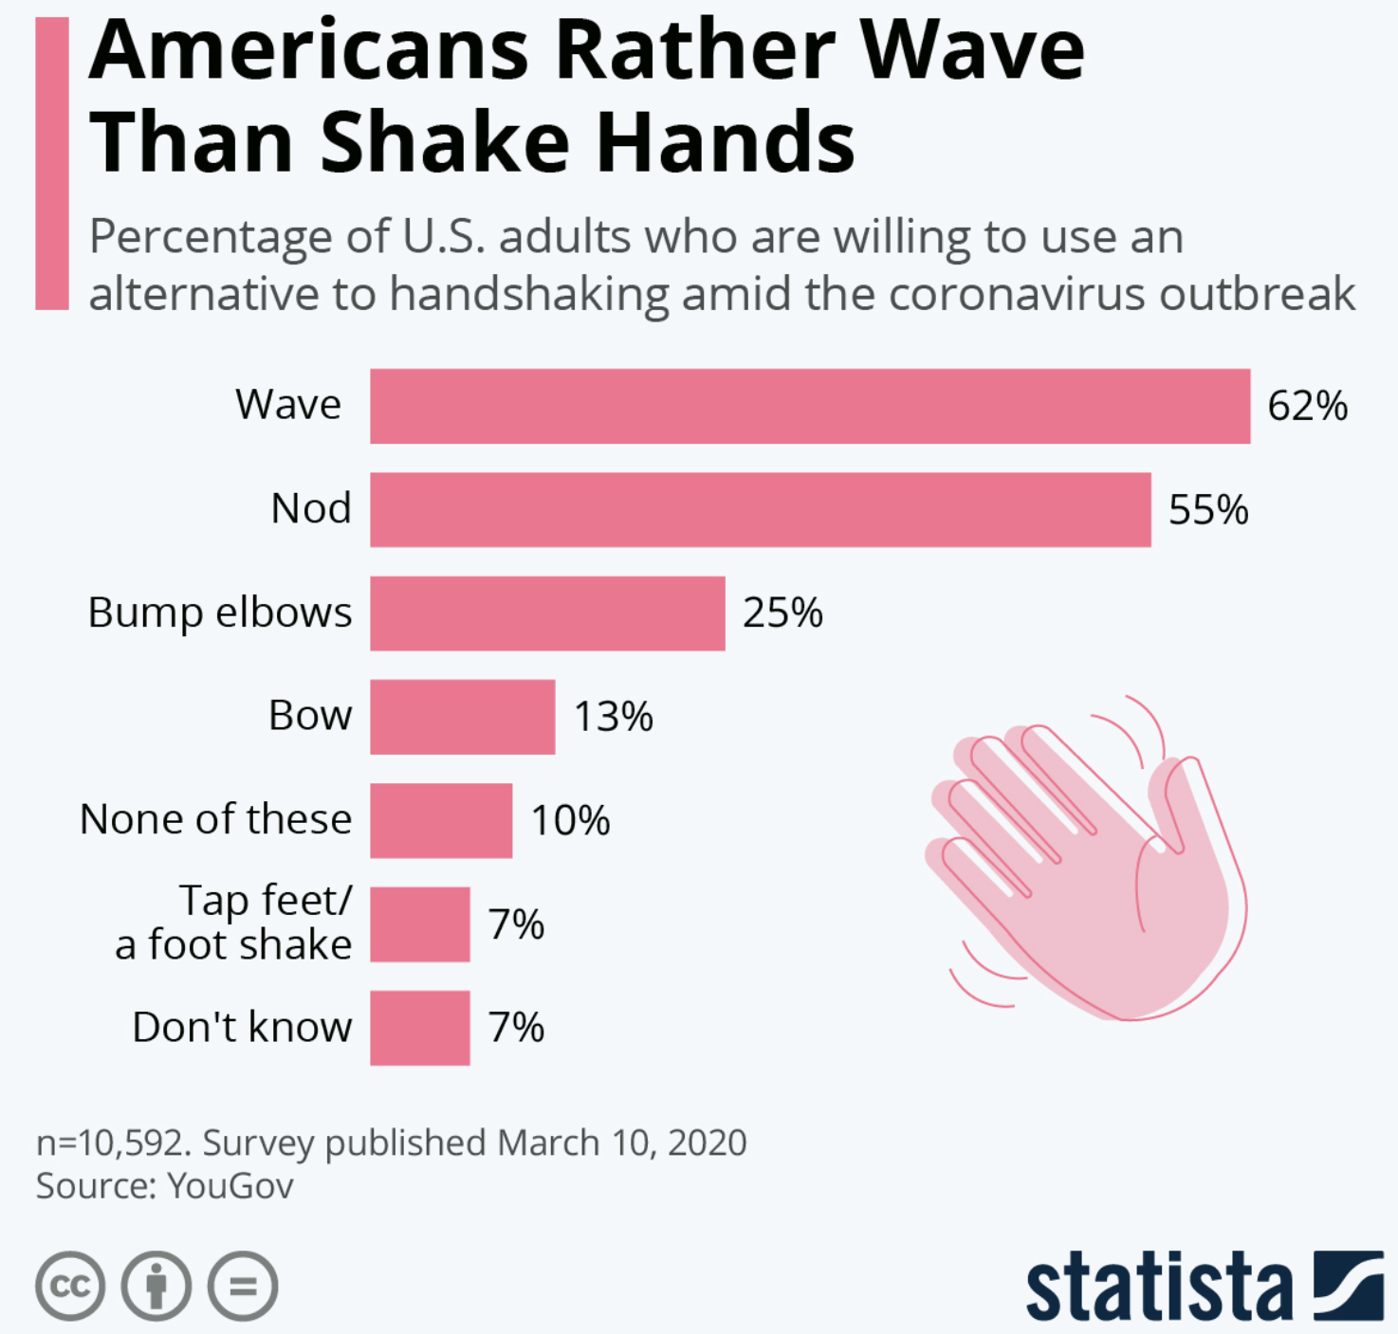
Other Factors
Super-Spreaders
Tend to Spread the Virus More Rapidly
May Take Time to Identify
Recognize and Limit Interactions in General

Slide 40
Other Factors
PPE Guidance
Refer to CDC Guidance on PPE Use
https://www.cdc.gov/coronavirus/2019-ncov/hcp/respirators-strategy/index.html
Especially Note the Banners at Bottom of Webpage
Consider Re-Use : Silicone Half Mask with N95
Double Glove Increases Protection When Re-Using Gear

Slide 41
Present Geographic Impact
Geography

Slide 42
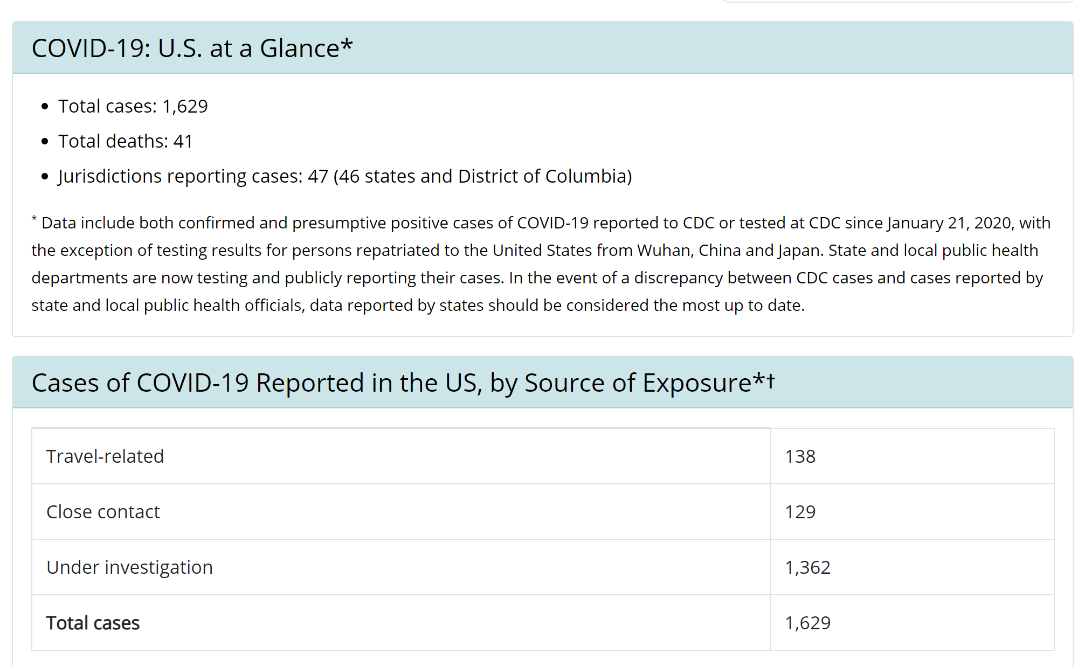
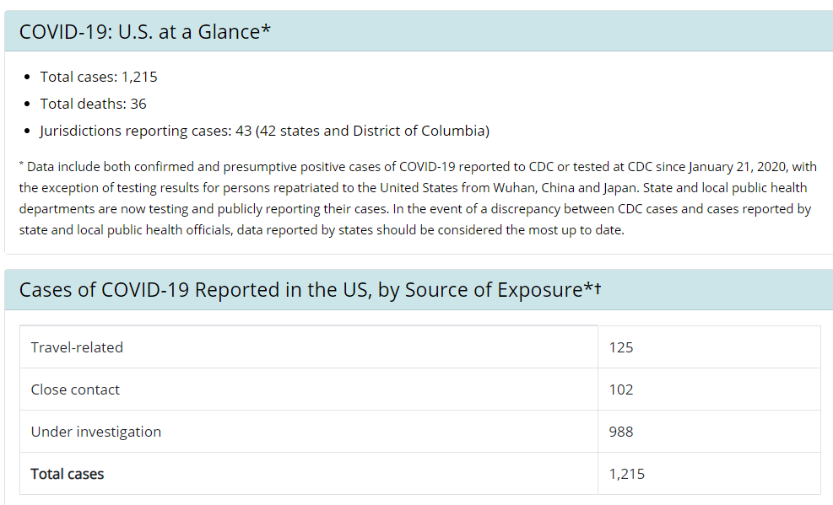
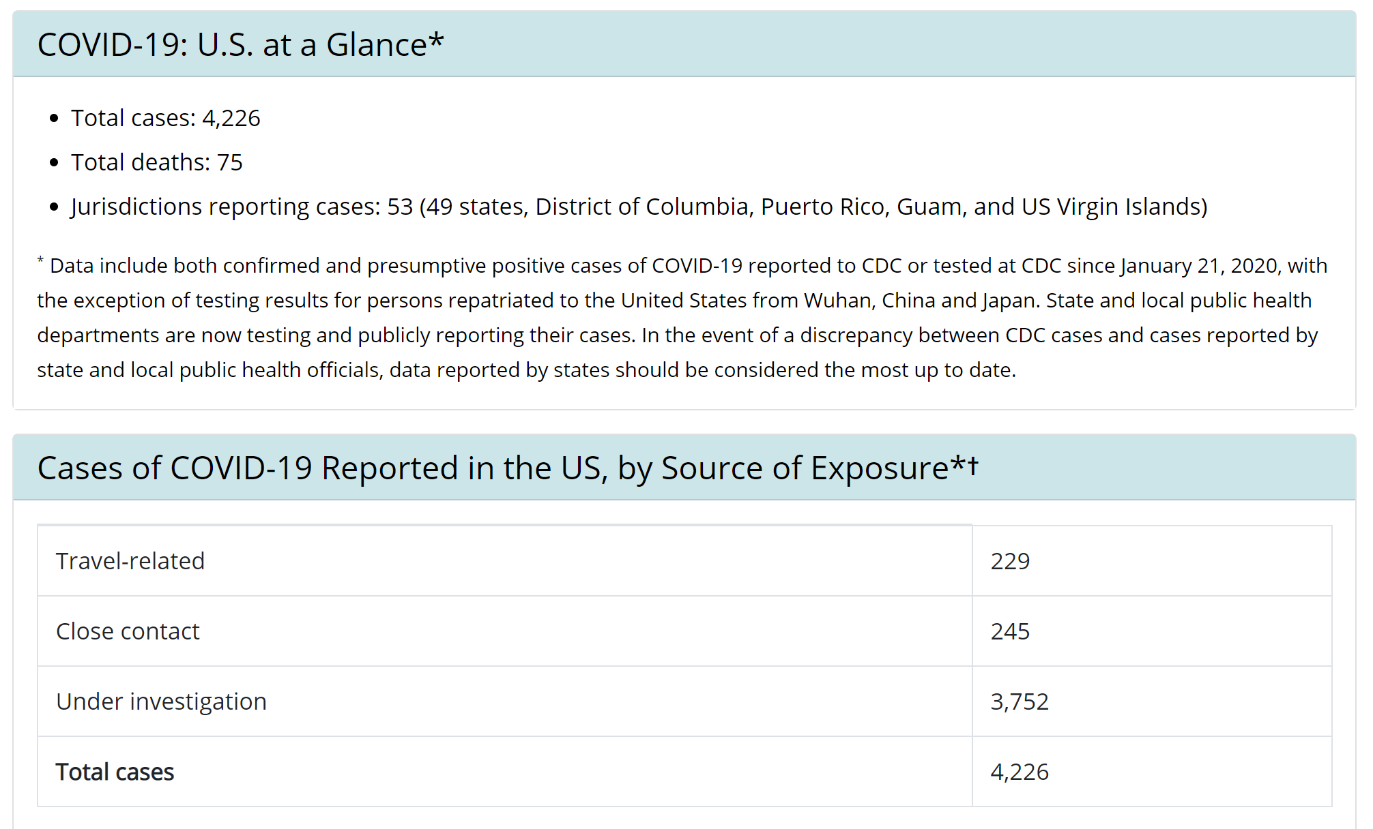
Present Geographic Impact
Geography
March 17, 2020

Slide 43
Present Geographic Impact
Geography
More info about the challenges in Italy:
https://medium.com/@tomaspueyo/coronavirus-act-today-or-people-will-die-f4d3d9cd99ca
Notes:
Thursday and Saturday charts

Slide 44
QUESTIONS?
COVID 19 GUIDANCE
Need Help? Have Questions?
Contact:
Michael.sheerin@tlc-eng.com

