Slide 1
INSTALLATION TIPS
Return air pmv kits

Slide 2
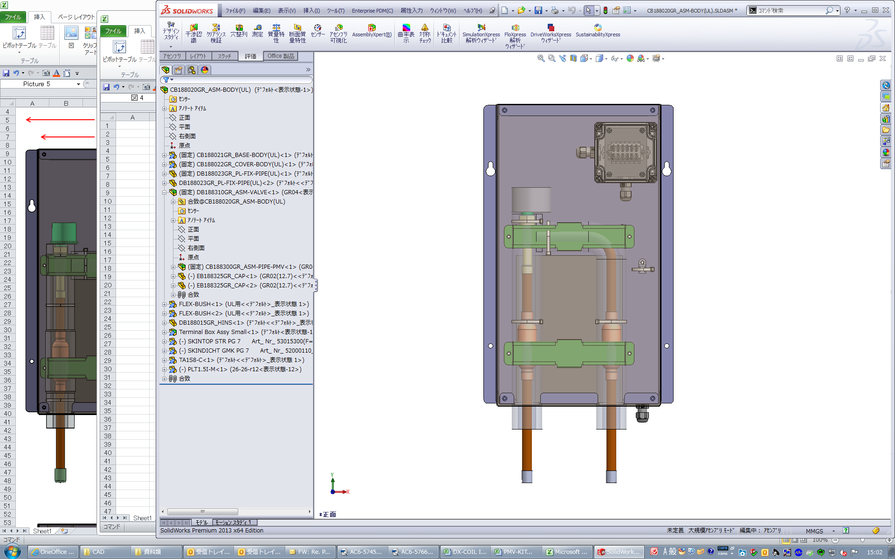
INSTALLATION TIPS – Return air pmv kits
Table of Contents
Table of contents
    Introduction
        PMV Kit Acronyms
        Return Air PMV Kit System Schematic
        PMV Application Approval Process Flow
        PMV Kit Sizes
        Field-Provided Scope
  Installation Details
    Parts Included with PMV Controller & PMV Kit
    Control Wire Specification
    Piping – PMV Kit Liquid line to IDU
    Piping – Gas and Liquid to IDU
    Coil Sensor Schematic
    Coil Sensor Holders
    Power Wiring
    Control Wiring – Required Connections
    Control Wiring – Optional Connections
    DN Code Settings
    Factory-Installed Relay Information

Slide 3
IntroDuction
PMV Kit Acronyms
Acronym | Stands For | Meaning
AHU | Air Handling Unit | Another term for “Indoor Unit”, “Fancoil”, etc.
BOM | Bill of Materials | List of equipment purchased for a job.
CFM | Cubic Feet Per Minute | Unit of measurement for airflow.
ESP | External Static Pressure | Unit of measurement for pressure difference across an AHU.
PMV | Pulse Motor Valve | Toshiba’s term for Electronic Expansion Valve.
Notes:
This presentation summarizes installation details for RETURN AIR PMV kits; this slide is basic housekeeping for acronyms.
Supplemental Notes:
ESP is called “external” to clarify that this pressure already accounts for internal pressure losses inside the AHU – such as filter, wet coil, etc.
CFM and ESP are inter-related. For any ducted application, check that the system curve (for ductwork, filters, etc.), intersects the fan curve(s) for AHU in “sweet spot” – i.e. close the middle.
PMV: called “EEV” or “LEV” by others, but it’s the same concept. It’s just our Electronic Expansion Valve - basically a needle valve with a stepper motor.

Slide 4
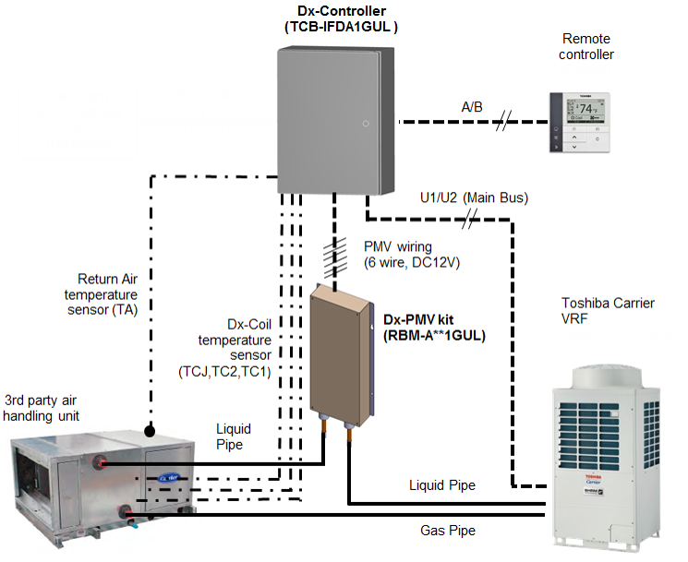
introduction
Return Air PMV Kit System Schematic
Refrigerant piping
Control wiring (Field installed)
Temperature sensor wiring
Notes:
The PMV Kits can be applied to “build-your-own” AHU with VRF expansion valve and IDU controls; behaves essentially like a conventional High Static Ducted TC VRF IDU.
Toshiba Carrier provides 2 pieces: PMV Kit & PMV Controller; the AHU and all inside “the box” are additional FIELD-SOURCED material. This essentially makes a high-static 1:1 Heat Pump in this schematic.

Slide 5

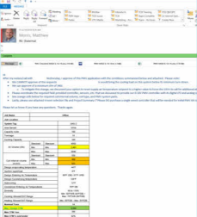
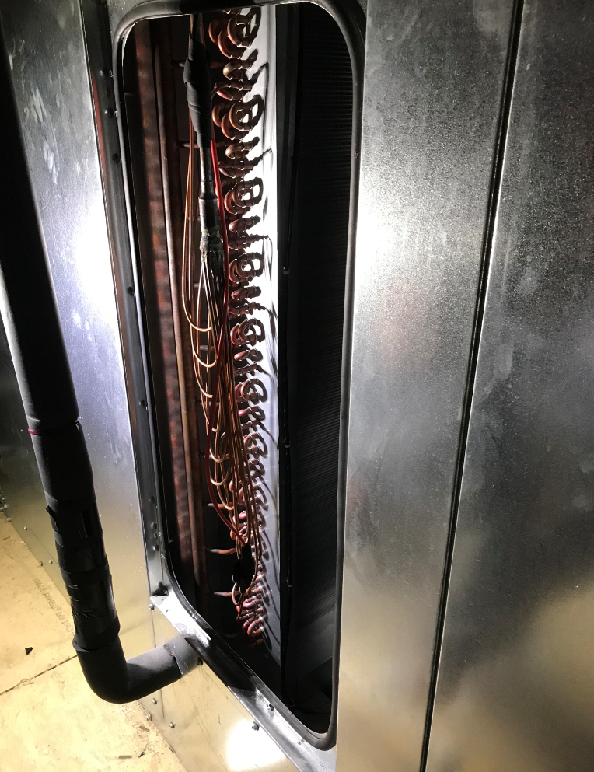
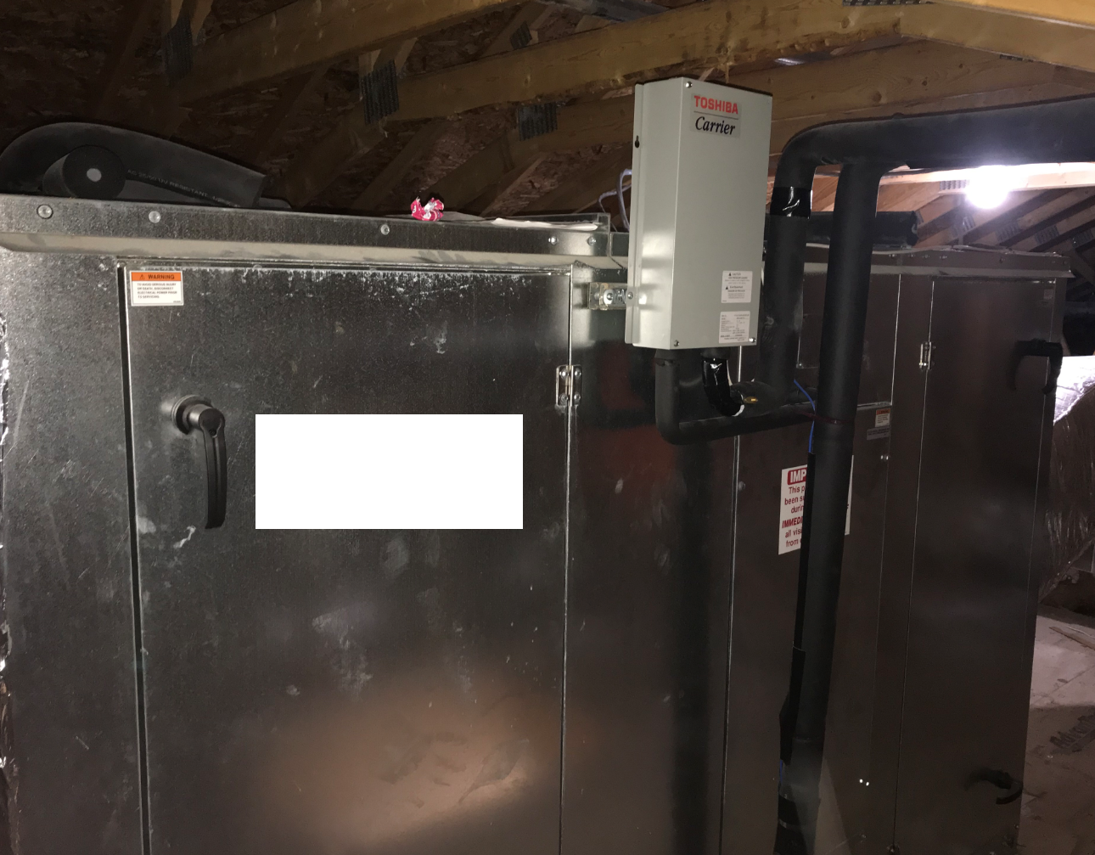
introduction
PMV Application Approval Process Flow
Distribution Sales Engineer (external)
Select AHU based on Airside requirements:
  CFM & ESP
  Cooling & Heating Capacities
Send the performance summary to VRF Product Group
Send expected Control Scheme to VRF Product Group
VRF Product Group (internal)
Investigate potential PMV Combos that meet Airside & Toshiba requirements using PMV Checklist.
If viable, approval via email:
  Contingent upon PMV Checklist (highlighted values)
  Include Vroom selection file for double-check of combos and BOM
Distributor Sales Engineer (external)
Source custom Heat Pump coils based on PMV Checklist requirements
Order equipment: Airside, Toshiba VRF, Custom Coils, Misc. Controls
Price & Coordinate Additional Labor & Misc. Parts for:
  Installing Custom Coil(s)
  Installing PMV Kit Piping
  Installing PMV Kit-Controller Wiring
Notes:
These kits are very exciting and flexible. However, these are an applied product that require additional care, parts sourcing, & coordination.
Please adhere to this process to obtain factory approval from Toshiba VRF. Please do not sell PMV Kits without approval email from VRF product group.

Slide 6
introduction
PMV Kit Sizes
PMV Kit Model Number | Capacity Code | Tonnage
RBM-A0121GUL | 012 | 1
RBM-A0301GUL | 015 | 1.3
 | 018 | 1.5
 | 021 | 1.8
 | 024 | 2
 | 030 | 2.5
RBM-A0601GUL | 036 | 3
 | 042 | 3.5
 | 048 | 4
 | 060 | 5
RBM-A0961GUL | 072 | 6
 | 096 | 8
RBM-A1921GUL | 168 | 14
 | 192 | 16
Notes:
Note that each PMV Kit model (above 1ton) covers MULTIPE CAPACITIES.
Capacities beyond 16-tons are available as COMBINATIONS of these individual PMV kits.

Slide 7
introduction
Field-Provided Scope
If PMV Application is approved by the factory, the following items will need to be sourced, installed, and “owned” by Sales Engineer in distribution & their contractors:
Parts:
  Custom Dx Coil(s) per our specifications, rated for Heat Pump duty with R-410A
  Misc. parts
    Wire for PMVs
    Wire for coil sensors
    External controls for start/stop
    Misc. wiring as needed (i.e. fan prover, float switches, CNs, etc.)
Labor
  Refrigerant Piping for Custom AHU & PMV Kit
    Piping from PMV to coil inlet / distributor
    Piping from coil gas header to stub-out
  Mount Coil Sensor Holders & Sensors
  Wiring
    208/230V 1ph power to Controller (like “normal” VRF IDU)
    Coil Sensors to PMV Controller
    PMV to PMV Controller
    Misc. interlocks as needed (i.e. fan proof, float switches to CN inputs)
Note: this is not an all-inclusive list. Please coordinate project specifics with Carrier Product group.
Notes:
Please reiterate that this is a highly APPLIED product and requires factory checks and approval for each application. Then, additional equipment and labor must be field-provided and coordinated.

Slide 8
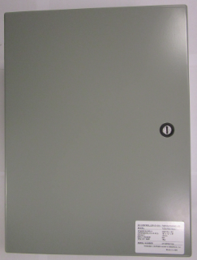
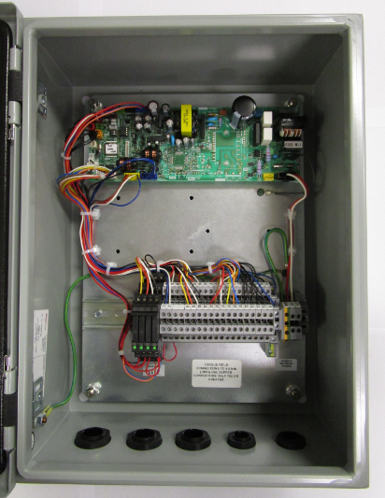
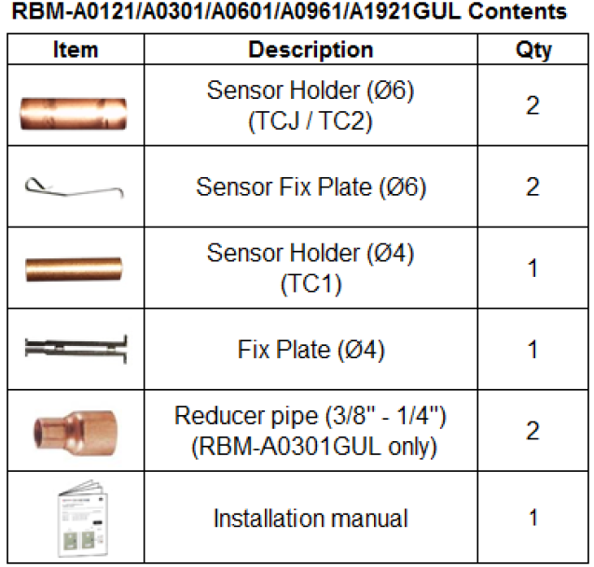
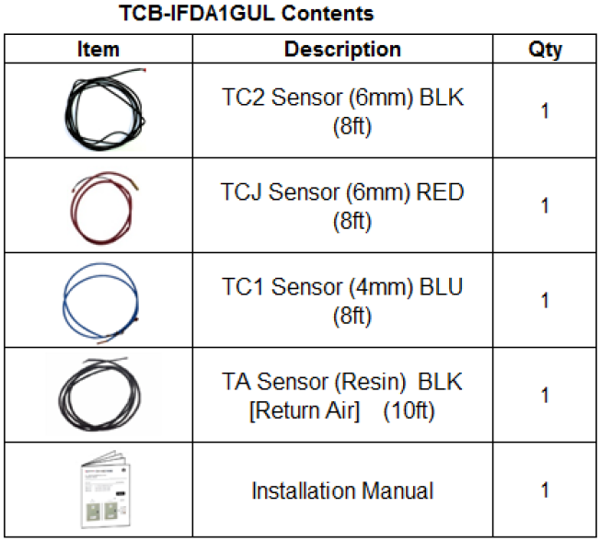
installation
Parts Included with PMV Controller & PMV Kit
Notes:
Note TCJ & TC2 are 6mm diameter (hence 2 holders and fix plates for these); TC1 is 4mm.

Slide 9
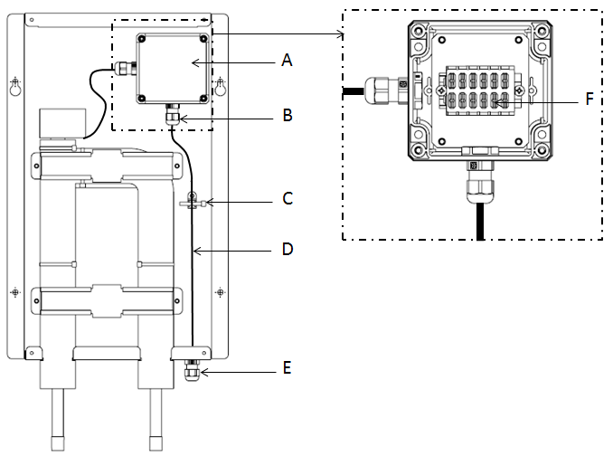
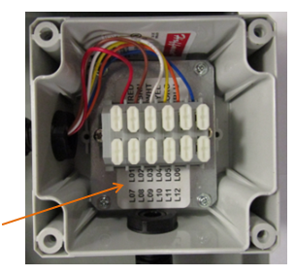
installation
Control Wire Specification
Terminal Numbers
PMV terminal box
Cable gland
Support tie wrap
PMV Wires (Field supply, 6or5 wires)
Cable gland
Terminal connector
Terminal number |  | RBM-A0121GUL A0301GUL A0601GUL A0961GUL | RBM-A1921GUL
PMV1 | PMV2
L01 | L07 | ✔ | ✔
L02 | L08 | ✔
L03 | L09 | ✔ | ✔
L04 | L10 | ✔ | ✔
L05 | L11 | ✔ | ✔
L06 | L12 | ✔ | ✔
Field-Supplied PMV Control Wiring
For | Use | Max. Length | Notes
PMV Wires | AWG 20 or 22, stranded, 6 conductors | 16 feet (piping max) | RBM-A1921GUL uses 5 wires; all other sizes – 6 wires.
TC1, TC2, TCJ, TA | AWG 20 or 22, stranded, 2 conductors | 16 feet (piping max) | TC1/2/J come with 8 feet of wire; TA comes with 10 feet.
Notes:
TC1/2/J/A shouldn’t need extension in most cases
Note that 14 & 16-ton kits use 5 wires; whereas others use 6.

Slide 10
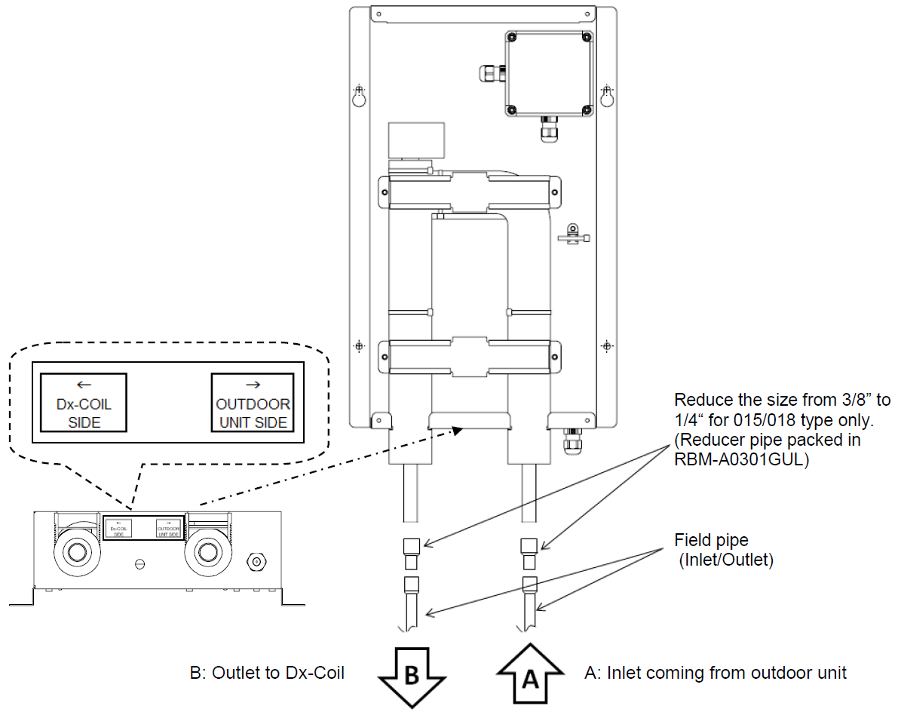
installation
Piping - PMV “liquid” line to IDU.
PMV Kit Model Number | Capacity Code | Tonnage | Piping Connection Size (in.)
RBM-A0121GUL | 012 | 1 | 1/4" x 1/4"
RBM-A0301GUL | 015 | 1.3 | 1/4" x 1/4" *Reducer 3/8"-1/4"
 | 018 | 1.5
 | 021 | 1.8 | 3/8" x 3/8"
 | 024 | 2
 | 030 | 2.5
RBM-A0601GUL | 036 | 3
 | 042 | 3.5
 | 048 | 4
 | 060 | 5
RBM-A0961GUL | 072 | 6 | 1/2" x 1/2"
 | 096 | 8
RBM-A1921GUL | 168 | 14 | 5/8" x 5/8"
 | 192 | 16
Notes:
Please remember these “Piping Connection Sizes” shown are for “liquid” pipe only; that’s why they’re both the same diameter; liquid into and out of PMV (during cooling mode).
Max pipe length between PMV Kit and Coil is 16 feet.

Slide 11
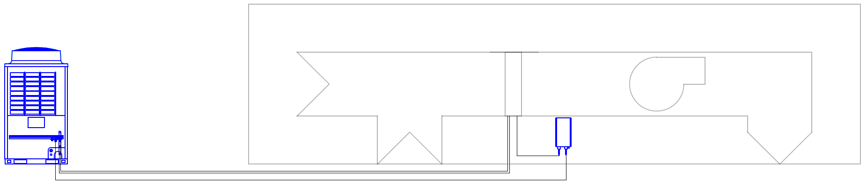
installation
Piping – Gas and Liquid to “IDU”
16 feet maximum
Dx-Coil Capacity Code (kBtuh) |  |  | Gas Side | Liquid Side
12 | Actual Pipe Length | 49ft or less | Φ3/8” | Φ1/4”
 |  | Over 49ft | Φ1/2” | Φ1/4”
15.4 to 18 |  |  | Φ1/2” | Φ1/4”
21 to 60 |  |  | Φ5/8” | Φ3/8”
72 to 96 |  |  | Φ7/8” | Φ1/2”
168 to 192 |  |  | Φ1-1/8” | Φ5/8”
Notes:
Note that these are the same pipe rules we have for normal TC VRF.

Slide 12
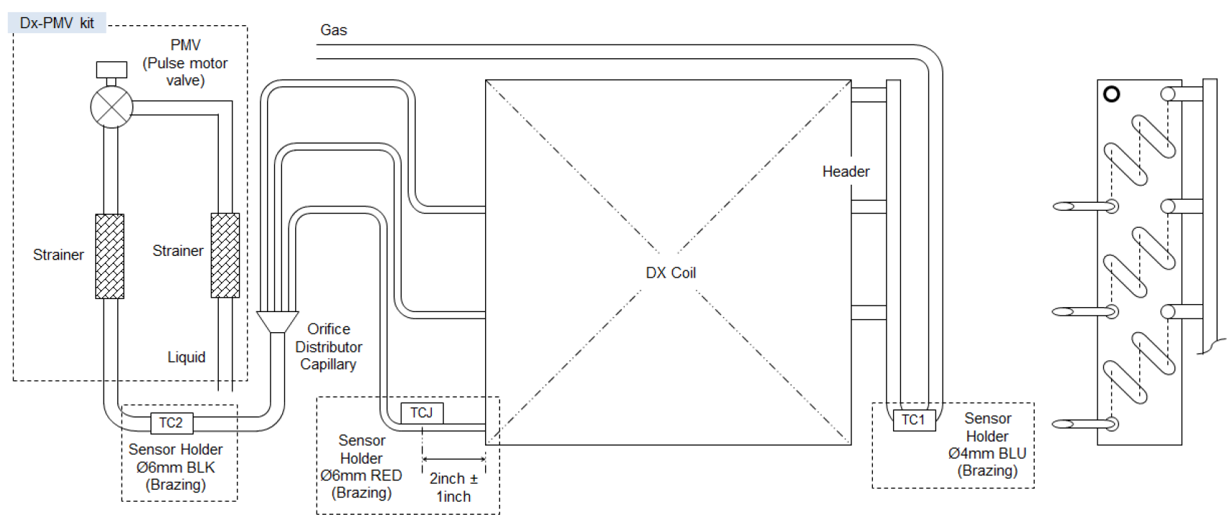
installation
Coil Sensors Schematic
Notes:
TC1, TC2, and TCJ connect to coil in locations shown. *Also, TA (Return Air) sensor gets mounted in return air stream.

Slide 13
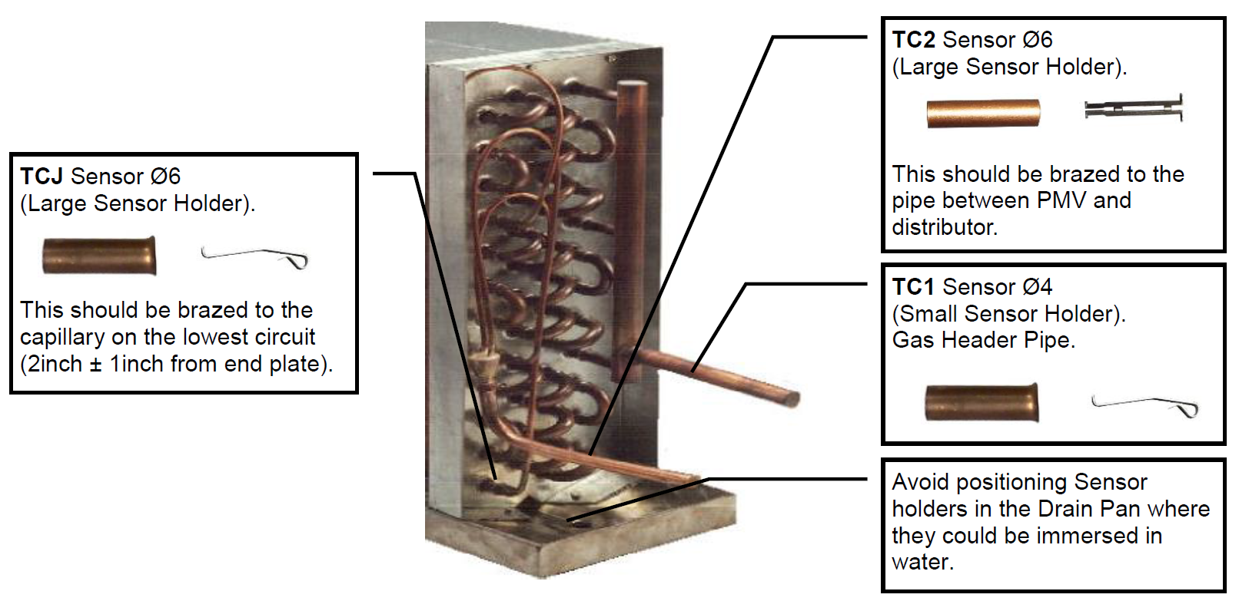
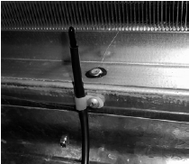
installation
Coil Sensor Holders
TA (Return Air Sensor) mounted at inlet of coil
Most sensitive part of sensor
Maximize contact with pipe
Notes:
Sensor Holders for TC1, TC2, and TCJ must be BRAZED to the coil in manner shown. Take care not to overheat or damage coil or surrounding components. Orient the the tip of the sensor towards the coil.
TA (Return Air) sensor must be mounted in coil inlet path, DOWNSTREAM of any mixing, pre-conditioning, etc.

Slide 14
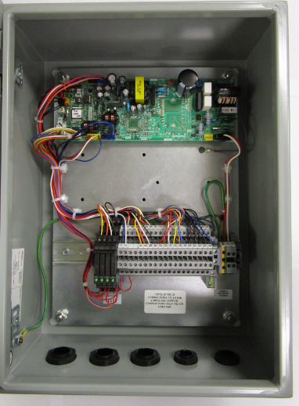
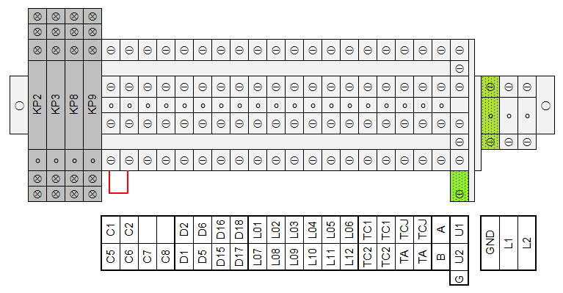
installation
Power Wiring
RA Controller (TCB-IFDA1GUL) Terminal Blocks
Power Supply: 208/230VAC 1ph 60Hz
MCA: 0.4A
MOCP: 15A
Notes:
The bottom row in diagram above are the labels for the terminal strips above and in picture. The terminal strips are have 2 tiers For example, the red jumper drawn is between C5&C6.
Provide it with 208/230V 1ph, MOCP of 15A – just like normal VRF IDUs.
***Note: power for fan(s) in AHU must be field-coordinated, provided, & wired separately.

Slide 15
installation
Control Wiring – Required Connections
RA Controller (TCB-IFDA1GUL) Terminal Blocks
FAN
CN34
(like water input on Verticals)
PMV Wires
Fan Output from CN60 via Relay KP2 (250VAC, 6A max)
TC1,TC2,TCJ,TA
U1/U2 Bus
A/B Bus
Notes:
These are the critical connections you must make for it to work.
Factory jumper installed on C5/C6 (which is from CN34 on board).
Note “KP” relays provided:
These are factory-included pilot relays that are triggered by normal CN outputs
Green LEDs light up when energized (“FAN” top left and in picture to the right)
See last slide for further details on relays
Note that we only have binary fan output – on/off; we DO NOT have ability to modulate fan speed.
Note 12 PMV Wire Terminals: Larger combo kits can use 2 PMVs; each PMV uses up to 6 wires.

Slide 16
installation
Control Wiring – Optional Connections
RA Controller (TCB-IFDA1GUL) Terminal Blocks
ALARM
THERMO
COOL/SEC
CN61 external on/off
CN61 alarm output
CN82
Thermo-on output
CN82 Cooling / Secondary Heating output
CN80 external error input (Normally-Open)
Notes:
We have many of the “normal” Toshiba CN I/O options available as well; reach out to Product team for details as needed for application.
Don’t forget jumper J01 on C1/C2 external on/off (next slide).

Slide 17
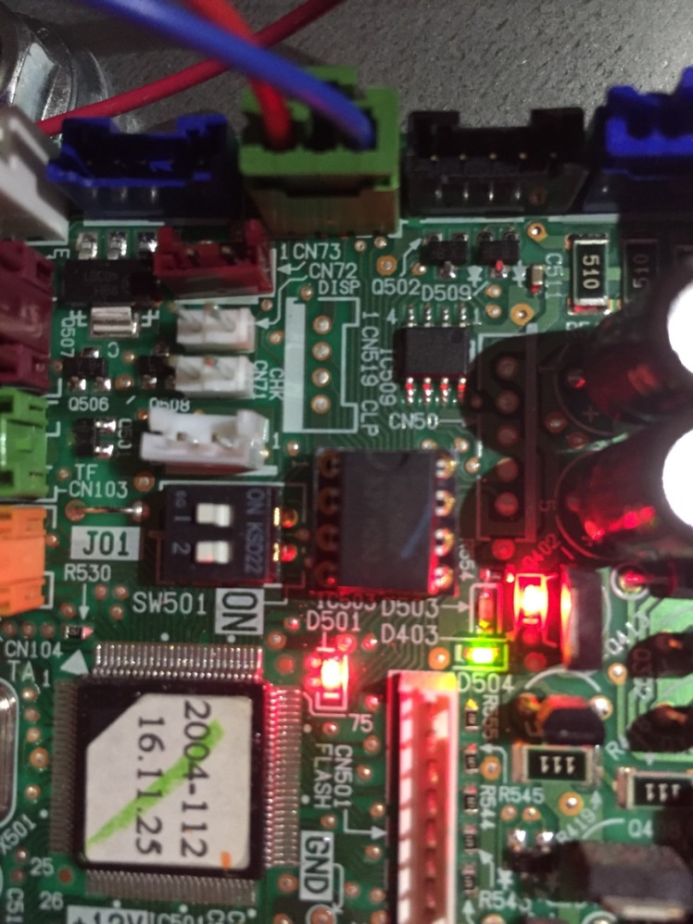
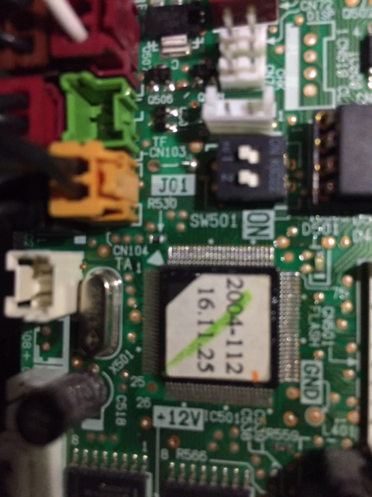
installation
Control Wiring – Optional Connections
Reminder:
C1,C2 uses familiar CN61 External On/Off input
Jumper J01 should be clipped for “switch” behavior; else “pulse” behavior.
Notes:
Just like normal applications with CN61 accessory, cut jumper J01 for normal “switch” response instead of pulse / “push button”.
Also, as we know, this input should NOT be used as a “thermostatic” on/off switch for BMS “temperature control”. (We speak from experience on this and previous misapplications.)

Slide 18
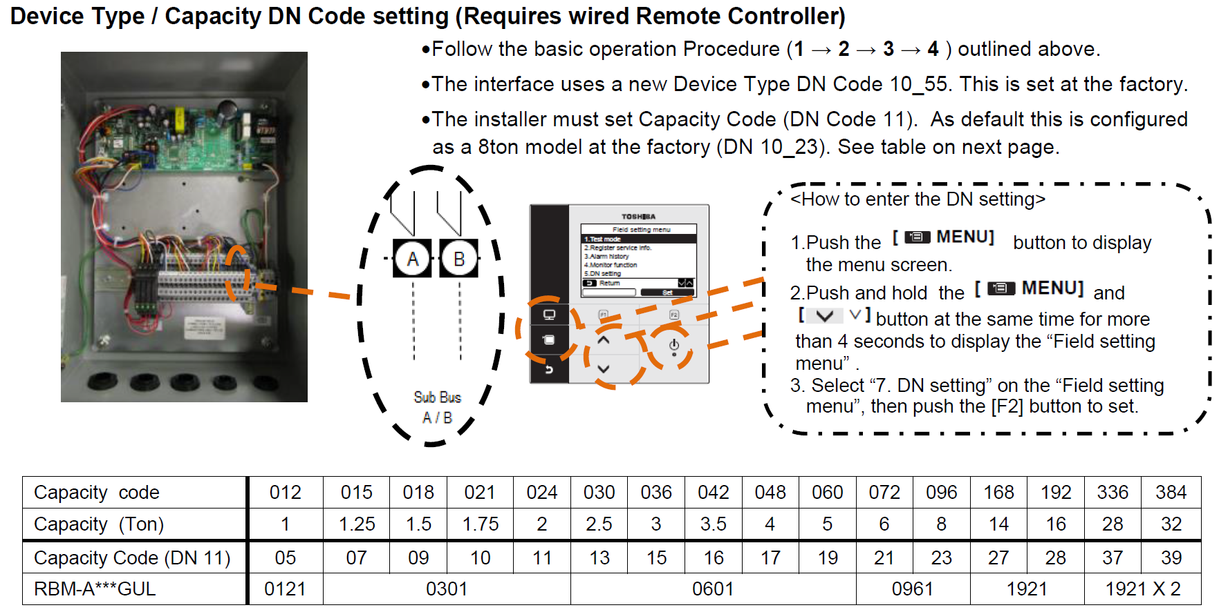
installation
DN Code Settings
Notes:
You have to tell the PMV Controller which size PMV kit is connected to it; this is done via DN11.

Slide 19
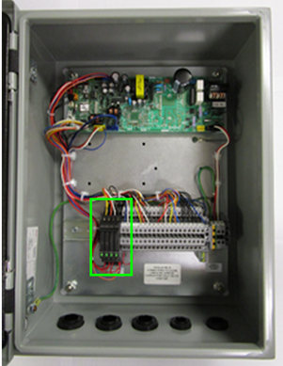
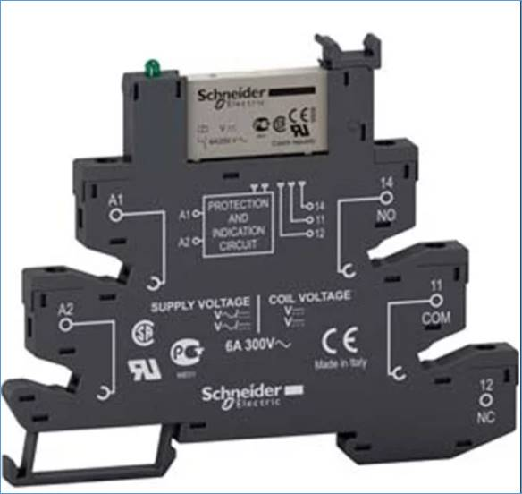
installation
Factory-Installed Relay Information
Qty. (4) factory-installed on DIN rail of PMV controller.
Outputs for Fan, Alarm, Thermo-On, and Cooling / Secondary Heat
No need to purchase “CN” accessory plugs & pilot relays for these outputs
  Relay Information:
  Make: Schneider
  Model: RSL1PVJU
  Coil: 12VDC
  Contact Load Current: 6A @ 250VAC
  Form: SPDT (Note NO, COM, NC in picture.)
Link to Schneider page:
https://www.schneider-electric.com/en/product/RSL1PVJU/slim-relay-mounted-on-screw-socket-with-led-and-protection-circuit%2C-12-v/
Notes:
Thank you!

