Slide 1
APPLICATION & dESIGN
Return air pmv kits

Slide 2
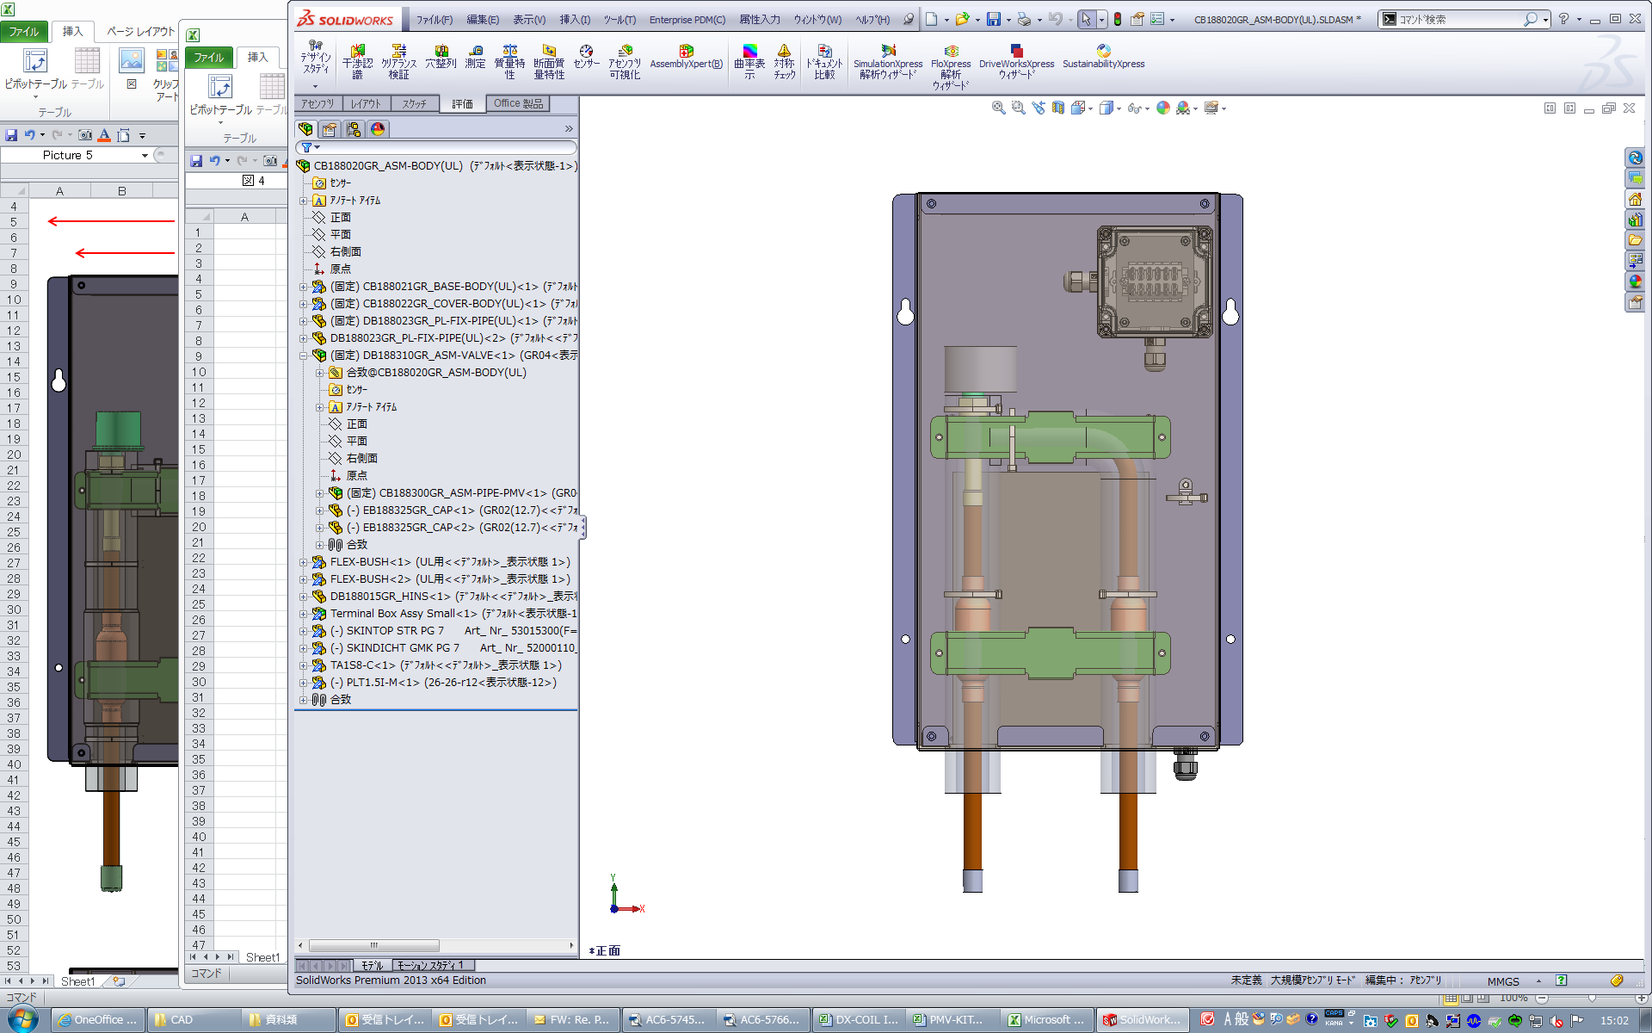
Application & design – Return air pmv kits
Table of Contents
Course objectives & Table of contents
Intro
Return Air PMV Kit System Schematic
PMV Application Approval Process Flow
Field-Provided Scope
Available Combinations
Decision-Making Tree
Key Questions
PMV Checklist
Entering Air Temperatures (EATs)
Application Scenarios
“Medium-Sized” AHUs
Custom Form Factors / Dimensions
Large AHUs
Benefits
Deep-Dive
Kit Sizes
DN Code Settings
Control Wiring – Required Connections
Control Wiring – Optional Connections
Factory-Installed Relay Information

Slide 3
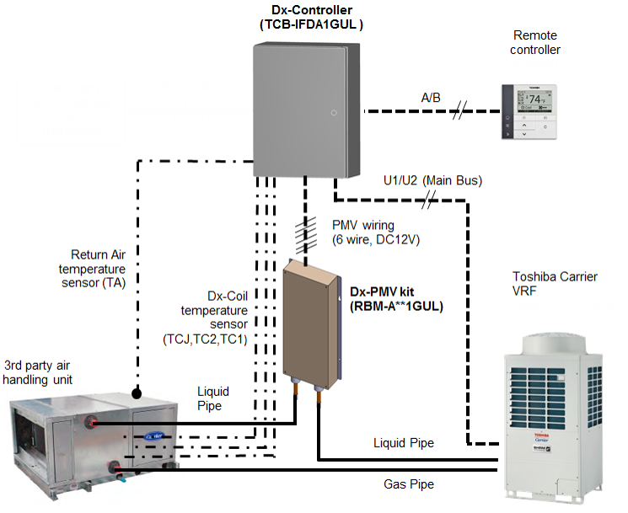
introduction
Return Air PMV Kit System Schematic
Refrigerant piping
Control wiring (Field installed)
Temperature sensor wiring
Notes:
The PMV Kits can be applied to “build-your-own” AHU with VRF expansion valve and IDU controls; behaves essentially like a conventional High Static Ducted TC VRF IDU.
Toshiba Carrier provides 2 pieces: PMV Kit & PMV Controller; the AHU and all inside “the box” are additional FIELD-SOURCED material. This essentially makes a high-static 1:1 Heat Pump in this schematic.

Slide 4

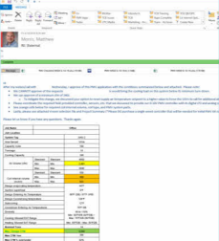
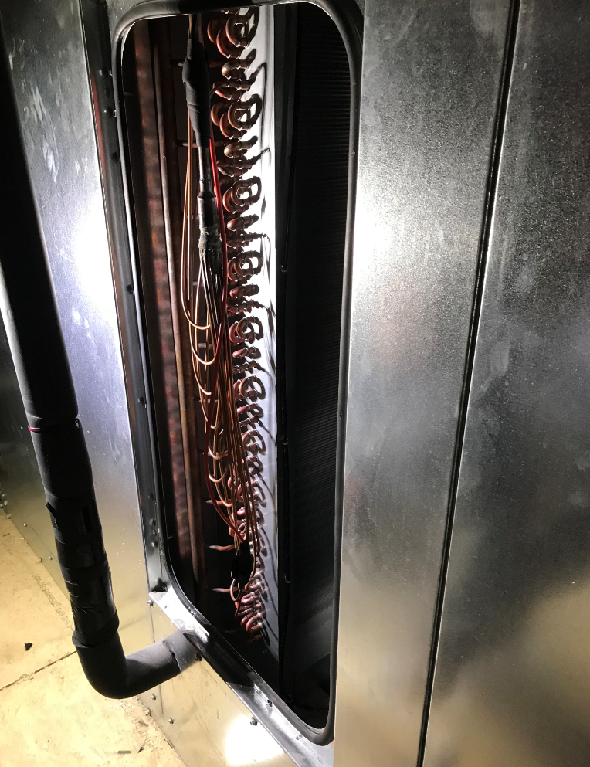
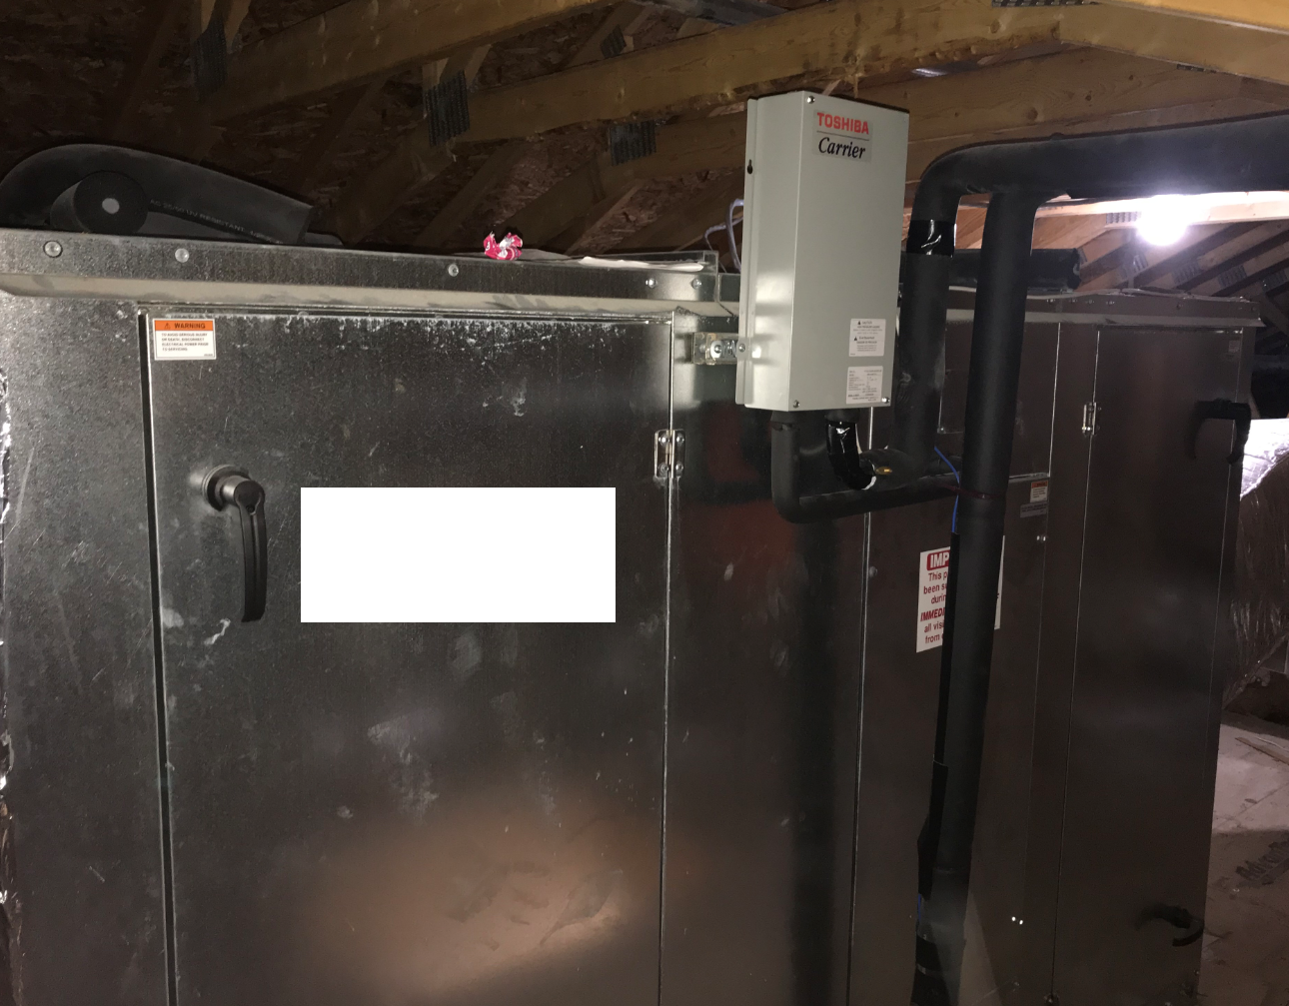
introduction
PMV Application Approval Process Flow
Distribution Sales Engineer (external)
Select AHU based on Airside requirements:
CFM & ESP
Cooling & Heating Capacities
Send the performance summary to VRF Product Group
Send expected Control Scheme to VRF Product Group
VRF Product Group (internal)
Investigate potential PMV Combos that meet Airside & Toshiba requirements using PMV Checklist.
If viable, approval via email:
Contingent upon PMV Checklist (highlighted values)
Include Vroom selection file for double-check of combos and BOM
Distributor Sales Engineer (external)
Source custom Heat Pump coils based on PMV Checklist requirements
Order equipment: Airside, Toshiba VRF, Custom Coils, Misc. Controls
Price & Coordinate Additional Labor & Misc. Parts for:
Installing Custom Coil(s)
Installing PMV Kit Piping
Installing PMV Kit-Controller Wiring
Notes:
These kits are very exciting and flexible. However, these are an applied product that require additional care, parts sourcing, & coordination.
Please adhere to this process to obtain factory approval from Toshiba VRF. Please do not sell PMV Kits without approval email from VRF product group.
Please also refer to PMV Kit Installation & Startup training PPT for details.

Slide 5
introduction
Field-Provided Scope
If PMV Application is approved by the factory, the following items will need to be sourced, installed, and “owned” by Sales Engineer in distribution & their contractors:
Parts:
Custom Dx Coil(s) per our specifications, rated for Heat Pump duty with R-410A
Misc. parts
Wire for PMVs
Wire for coil sensors
External controls for start/stop
Misc. wiring as needed (i.e. fan prover, float switches, CNs, etc.)
Labor:
Refrigerant Piping for Custom AHU & PMV Kit
Piping from PMV to coil inlet / distributor
Piping from coil gas header to stub-out
Mount Coil Sensor Holders & Sensors
Wiring
208/230V 1ph power to Controller (like “normal” VRF IDU)
Coil Sensors to PMV Controller
PMV to PMV Controller
Misc. interlocks as needed (i.e. fan proof, float switches to CN inputs)
Note: this is not an all-inclusive list. Please coordinate project specifics with Carrier Product group.
Notes:
Please reiterate that this is a highly APPLIED product and requires factory checks and approval for each application. Then, additional equipment and labor must be field-provided and coordinated.

Slide 6
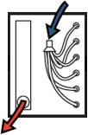
introduction
Available Combinations – Normal Coils
DX-coil type |  |  | Normal (Single-Circuit)
Capacity | Capacity Code |  | 012 | 015 | 018 | 021 | 024 | 030 | 036 | 042 | 048 | 060 | 072 | 096 | 168 | 192 | 336 | 384
 | Tonnage |  | 1 | 1.25 | 1.5 | 1.75 | 2 | 2.5 | 3 | 3.5 | 4 | 5 | 6 | 8 | 14 | 16 | 28 | 32
Controller | TCB-IFDA1GUL |  | 1 | 1 | 1 | 1 | 1 | 1 | 1 | 1 | 1 | 1 | 1 | 1 | 1 | 1 | 1 | 1
Dx-PMV Kit | RBM-A0121GUL | 1 | 1
 | RBM-A0301GUL | 1.3 |  | 1
 |  | 1.5 |  |  | 1
 |  | 1.8 |  |  |  | 1
 |  | 2 |  |  |  |  | 1
 |  | 2.5 |  |  |  |  |  | 1
 | RBM-A0601GUL | 3 |  |  |  |  |  |  | 1
 |  | 3.5 |  |  |  |  |  |  |  | 1
 |  | 4 |  |  |  |  |  |  |  |  | 1
 |  | 5 |  |  |  |  |  |  |  |  |  | 1
 | RBM-A0961GUL | 6 |  |  |  |  |  |  |  |  |  |  | 1
 |  | 8 |  |  |  |  |  |  |  |  |  |  |  | 1
 | RBM-A1921GUL | 14 |  |  |  |  |  |  |  |  |  |  |  |  | 1 |  | 2
 |  | 16 |  |  |  |  |  |  |  |  |  |  |  |  |  | 1 |  | 2
Applied | Mixing with normal FCU |  | Yes with PMV Kits 8-ton or less. |  |  |  |  |  |  |  |  |  |  |  | No
 | Group Control |  | Yes |  |  |  |  |  |  |  |  |  |  |  | No
Outdoor Unit | SMMS-e (Heat Pump) |  | Yes |  |  |  |  |  |  |  |  |  |  |  | Yes
 | SHRM-e (Heat Recovery) |  | Yes |  |  |  |  |  |  |  |  |  |  |  | No
 | MCY (Single-Phase Heat Pump 3,4,5 ton) |  | Yes |  |  |  |  |  |  |  |  |  | No |  | No
Normal (Single-Circuit) Coil
Notes:
Note break at 8 tons

Slide 7
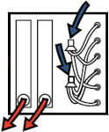
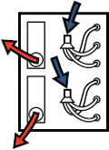
introduction
Available Combinations – Interlaced & Face-Split Coils
DX-coil type |  |  | Interlaced or Face-Split
Capacity | Capacity Code |  | 120 | 144 | 216 | 240 | 264 | 288 | 336 | 384
 | Tonnage |  | 10 | 12 | 18 | 20 | 22 | 24 | 28 | 32
Controller | TCB-IFDA1GUL |  | 2 | 2 | 3 | 3 | 3 | 3 | 2 | 2
 | RBM-A0601GUL | 5 | 2
 | RBM-A0961GUL | 6 |  | 2 | 3 | 2 | 1
 |  | 8 |  |  |  | 1 | 2 | 3
 | RBM-A1921GUL | 14 |  |  |  |  |  |  | 2
 |  | 16 |  |  |  |  |  |  |  | 2
Applied | Mixing with normal FCU |  | No
 | Group Control |  | No
Outdoor Unit | SMMS-e (Heat Pump) |  | Yes
 | SHRM-e (Heat Recovery) |  | No
 | MCY (Single-Phase Heat Pump 3,4,5 ton) |  | No
Interlaced Coil
Face-Split Coil

Slide 8
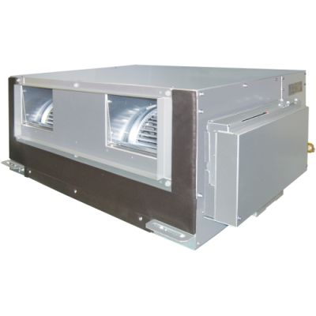
Decision-making tree
Key Questions
Will a “normal” Toshiba Carrier IDU suffice?
If yes, go with that first.
Is Heat Recovery required?
If yes, 8 tons max per AHU w PMV kit.
Mixing with “normal” Toshiba Carrier IDUs?
If yes, 8 tons max per AHU w PMV kit.
Can the project support additional work required?
Additional field-provided parts, labor, and project management.
Can we “meet the numbers”?
See PMV Checklist…
Notes:
Look for simplest solution first. If conventional VRF ducted IDUs can be used, consider these first.

Slide 9
Decision-making tree
PMV Checklist
Job Name | Example
Job Location | Memphis, TN
System Tag |  |  | AHU-12
Area Served |  |  | Jungle Room
Capacity code |  |  | 192
Tonnage |  |  | 16
Air Volume (cfm) | Standard: | Standard | 4,950
 | Min: | Min. | 3,960
 | Max: | Max. | 5,940
Coil internal volume (inch3) | Standard: | Standard | 610
 | Min: | Min. | 519
 | Max: | Max. | 702
Enter Project Requirements | Nominal Tons |  | 16
 | CFM |  | 6,000
 | CFM / ton |  | 357
 | CFM % over/under |  | 101%
 | Total Cooling (MBH) |  | 201.5
 | Sensible Cooling (MBH) |  | 131.1
 | Sensible Ratio |  | 65%
 | EAT Cooling (DB) |  | 80.0
 | EAT Cooling (WB) |  | 67.0
 | Total Heating (MBH) |  | N/A
 | EAT Heating (DB) |  | N/A
 | Control Type |  | Return Air
 | Coil Config. |  | Normal (Single-Circuit)
Enter Actual | Custom Coil Internal Volume (inch3) |  | 692.00
Controller Quantities:
TCB-IFDA1GUL | (RA Control) |  | 1
Dx Kit Model: | Coil Capacity (MBH) |  | Kit Quantities:
RBM-A1921GUL | 168
 | 192 |  | 1
The PMV Checklist is used by Carrier VRF Product Group in approval process
Yellow cells are critical metrics that are required for approval
Green cells are metrics verified within range
Orange cells are FYI on PMV & Controller Kit quantities
Notes:
Walk through 10 critical metrics in yellow
(Tip: ~300cfm/ton)

Slide 10
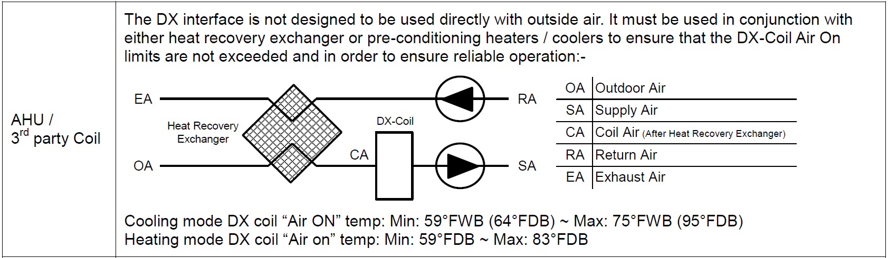
Decision-making tree
Entering Air Temperatures (EATs)
Allowed EATs are the same as “normal” Toshiba-Carrier IDU
If conditioning small percentage of outside air, an ERV may help mitigate EATs
Run mixed-air calculations to make sure they’re in range of allowed EATs
Notes:
Snip taken from RA Controller Installation manual.
Translation: “Air On” = Entering Air.

Slide 11
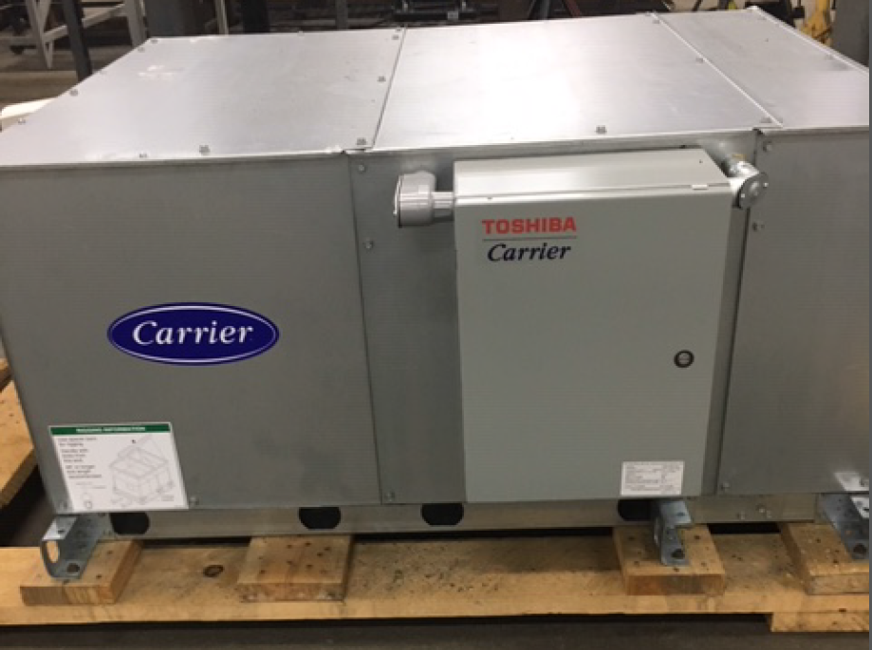
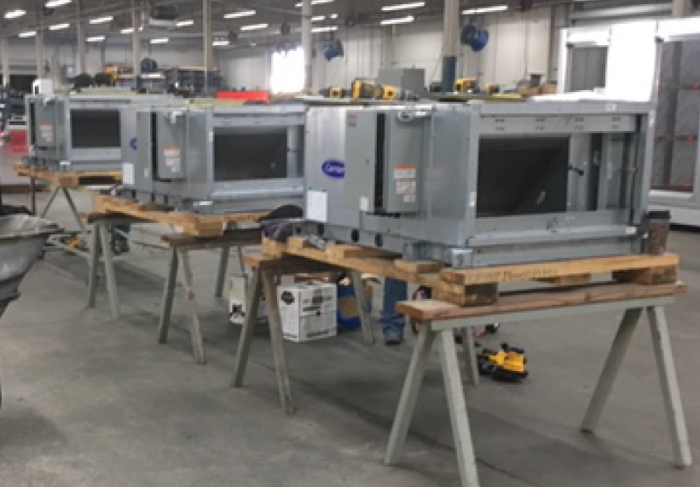
Application scenarios
“Medium-sized” AHUs
Carrier 39L
For projects with multiple, “medium-sized” AHUs, kits can be installed offsite
Potential economies of scale and “sweet spot”
Notes:
Picture from “assembly line” application from distributor with multiple 39Ls. PMV kits installed in their warehouse with 39Ls kept on pallet; shrink-wrapped for shipment to jobsite.

Slide 12
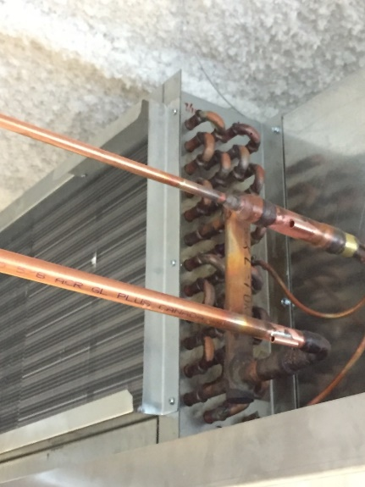
Application scenarios
Custom Form Factors / Dimensions
PMV Kits can be adapted to virtually any style of AHU, as long as we meet requirements. (Refer to PMV Checklist)
Low-Profile 3rd-Party AHU
Notes:
Note temp sensors brazed on at angle

Slide 13
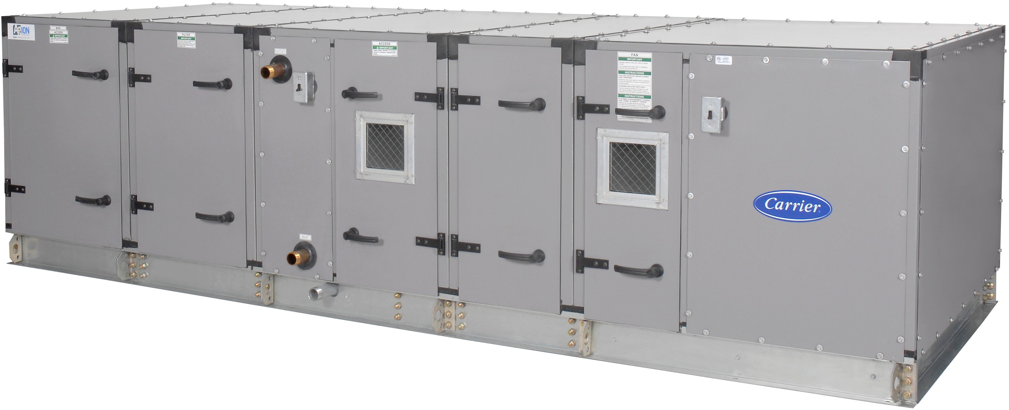
Application scenarios
Large AHUs
Carrier 39M
Carrier 39M
Up to 32-ton systems available
For large, open, conditioned spaces that function well as “single-zone”
i.e. warehouse, gym, auditorium, etc.
Notes:
39M shown as example.
Interesting “balance” from VRF application perspective: large single-zone ducted is generally antithetical to VRF, but this is “hybrid” that brings VRF’s efficiency, precision, and low-noise to large AHUs.

Slide 14
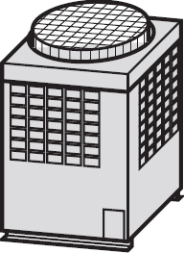


Application scenarios
Large AHUs
DX controller
AHU
TA
U1/U2
TC2
TC1
TCJ
TA
TC2
TC1
TCJ
TA
TC2
U5/U6
TC1
TCJ
A/B
Dx-PMV kit
Face-split coils get “stacked”
PMV
PMV
PMV
Remote
controller
Liquid pipe
Gas Pipe

Slide 15
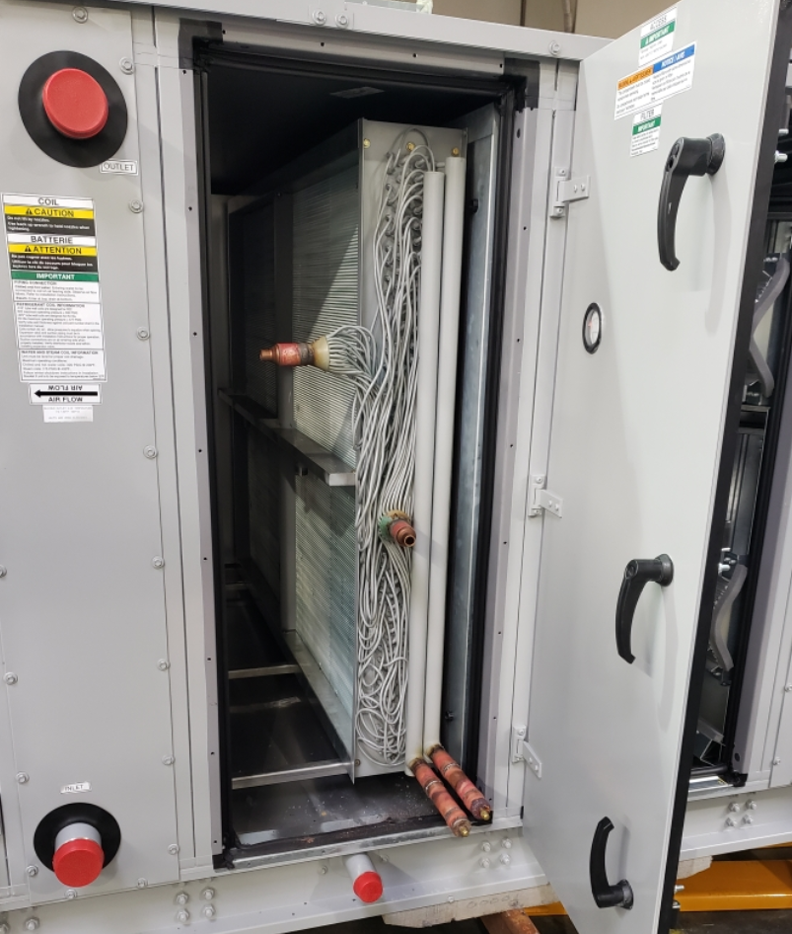
Application scenarios
Benefits
General Benefits
Flexibility to use AHU manufacturer’s accessories
Can address ventilation / OA requirements
“Muscle” of commercial AHU + precision of VRF ODU
Can be combined to make VERY large Dx AHUs (> 32 tons)
For retrofits
Existing AHU can be reused (large, built-ups for example)
Modular ODUs can fit in freight elevator (may not need crane, helicopter, etc.)
Minimally-invasive indoor work
Custom Coil in Large AHU
Notes:
Custom coil in Large AHU picture is of an Interlaced coil (see feeds coming off of the 2 distributors on upper/left).

Slide 16
Deep dive
PMV Kit Sizes
PMV Kit Model Number | Capacity Code | Tonnage
RBM-A0121GUL | 012 | 1
RBM-A0301GUL | 015 | 1.3
 | 018 | 1.5
 | 021 | 1.8
 | 024 | 2
 | 030 | 2.5
RBM-A0601GUL | 036 | 3
 | 042 | 3.5
 | 048 | 4
 | 060 | 5
RBM-A0961GUL | 072 | 6
 | 096 | 8
RBM-A1921GUL | 168 | 14
 | 192 | 16
Notes:
Note that each PMV Kit model (above 1ton) covers MULTIPE CAPACITIES.
Capacities beyond 16-tons are available as COMBINATIONS of these individual PMV kits.

Slide 17
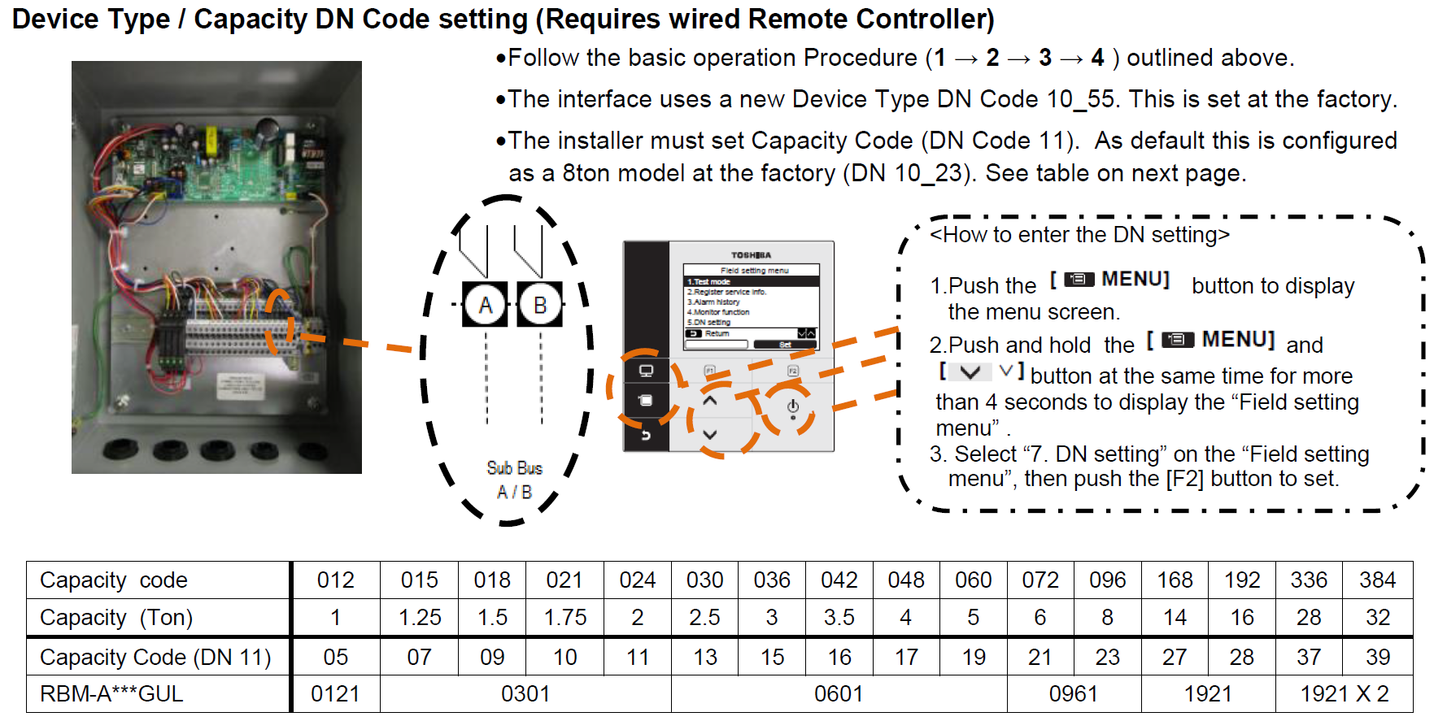
Deep-dive
DN Code Settings
Notes:
You have to tell the PMV Controller which size PMV kit is connected to it; this is done via DN11.

Slide 18
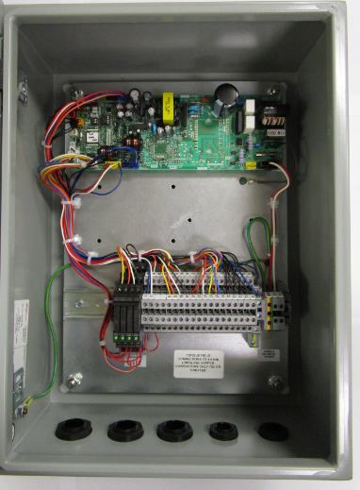
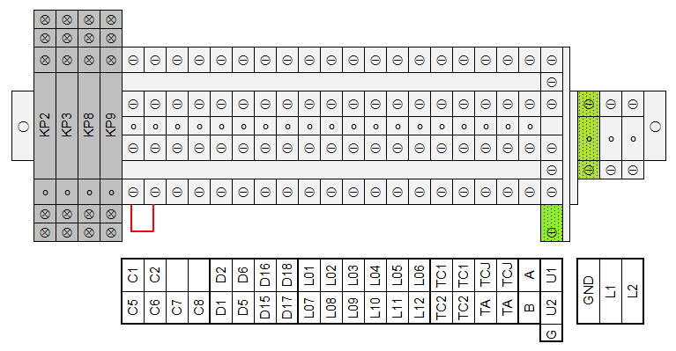
installation
Control Wiring – Required Connections
RA Controller (TCB-IFDA1GUL) Terminal Blocks
FAN
CN34
(like water input on Verticals)
PMV Wires
Fan Output from CN60 via Relay KP2 (250VAC, 6A max)
TC1,TC2,TCJ,TA
U1/U2 Bus
A/B Bus
Notes:
These are the critical connections you must make for it to work.
Factory jumper installed on C5/C6 (which is from CN34 on board).
Note “KP” relays provided:
These are factory-included pilot relays that are triggered by normal CN outputs
Green LEDs light up when energized (“FAN” top left and in picture to the right)
See last slide for further details on relays
Note that we only have binary fan output – on/off; we DO NOT have ability to modulate fan speed.
Note 12 PMV Wire Terminals: Larger combo kits can use 2 PMVs; each PMV uses up to 6 wires.

Slide 19
installation
Control Wiring – Optional Connections
RA Controller (TCB-IFDA1GUL) Terminal Blocks
ALARM
THERMO
COOL/SEC
CN61 external on/off
CN61 alarm output
CN82
Thermo-on output
CN82 Cooling / Secondary Heating output
CN80 external error input (Normally-Open)
Notes:
We have many of the “normal” Toshiba CN I/O options available as well; reach out to Product team for details as needed for application.
Don’t forget jumper J01 on C1/C2 external on/off (next slide).

Slide 20
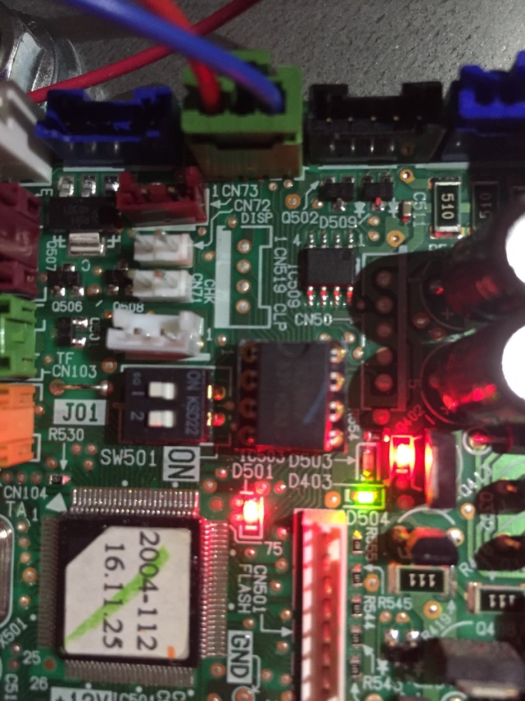
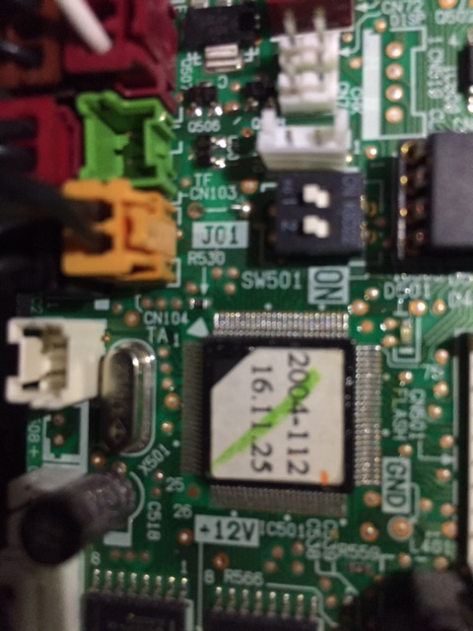
Deep dive
Control Wiring – Optional Connections
Reminder:
C1,C2 uses familiar CN61 External On/Off input
Jumper J01 should be clipped for “switch” behavior; else “pulse” behavior.
Notes:
Just like normal applications with CN61 accessory, cut jumper J01 for normal “switch” response instead of pulse / “push button”.
Also, as we know, this input should NOT be used as a “thermostatic” on/off switch for BMS “temperature control”. (We speak from experience on this and previous misapplications.)

Slide 21
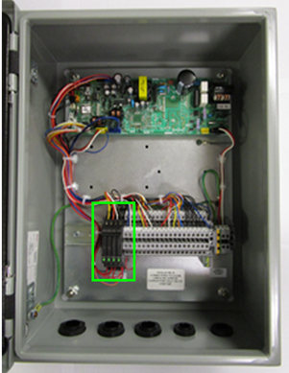
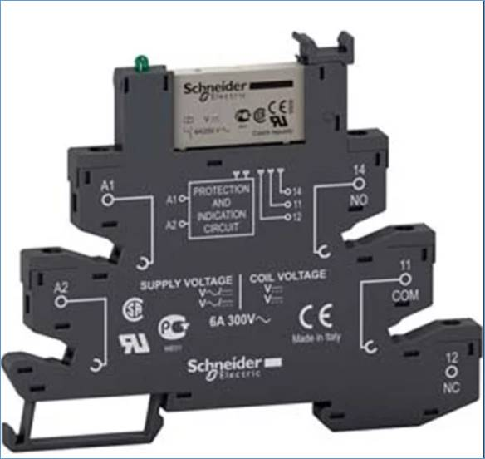
Deep dive
Factory-Installed Relay Information
Qty. (4) factory-installed on DIN rail of PMV controller.
Outputs for Fan, Alarm, Thermo-On, and Cooling / Secondary Heat
No need to purchase “CN” accessory plugs & pilot relays for these outputs
Relay Information:
Make: Schneider
Model: RSL1PVJU
Coil: 12VDC
Contact Load Current: 6A @ 250VAC
Form: SPDT (Note NO, COM, NC in picture.)
Link to Schneider page:
https://www.schneider-electric.com/en/product/RSL1PVJU/slim-relay-mounted-on-screw-socket-with-led-and-protection-circuit%2C-12-v/
Notes:
Thank you!

